Slide 1
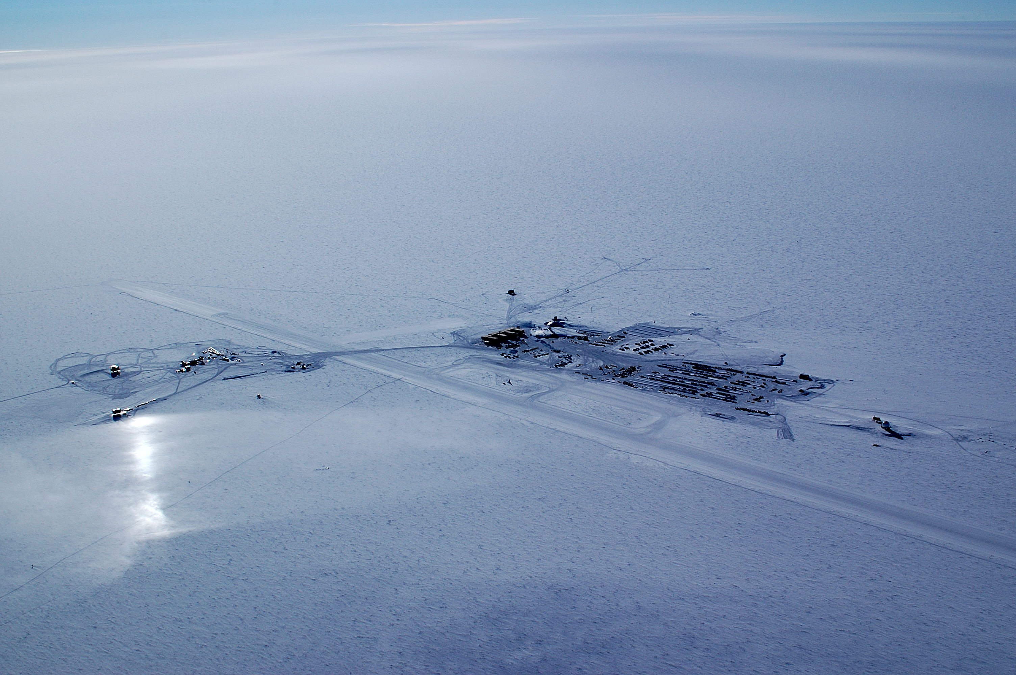

South Pole
Searching for Neutrinos – Project IceCube
Jim Haugen / Terry Benson

Slide 2
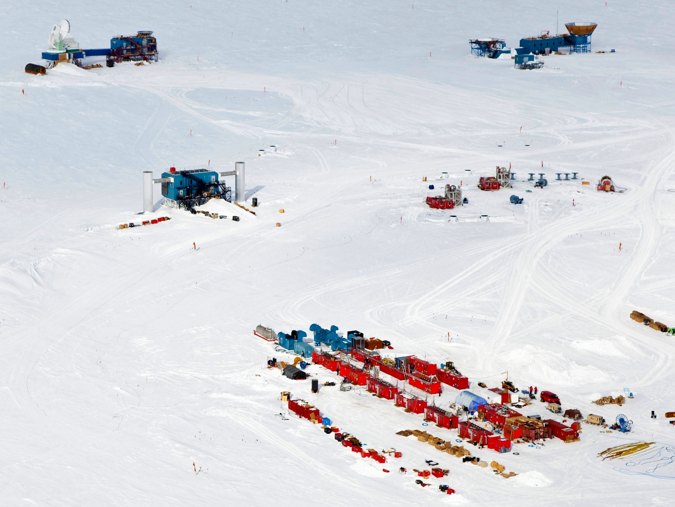




Slide 3

Briefly, what is IceCube?
This is a federally funded project administered through the National Science Foundation
We are in our 10th project year and completed construction in 2011
We built a Neutrino Telescope (a unique telescope) at the South Pole
Total budget for the project is ~$280M with all US funding managed at the University of Wisconsin
Here is the best part - on time, on budget, on schedule and …..the darn thing works!!!!
http://icecube.wisc.edu/

Slide 4
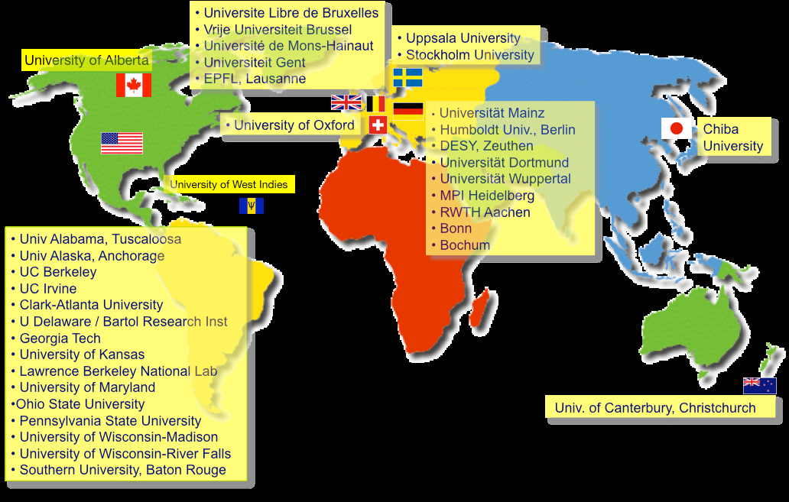
The IceCube Collaboration
250 scientists
36 institutions
4 continents

Slide 5
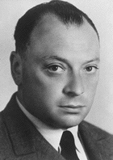
The Neutrino
"I have done a terrible thing - I have invented a particle that cannot be detected"
-- Wolfgang Pauli, 1930
  n –> p + e- + __? (conserve energy + momentum)
“Tiny bits of almost nothing”
no charge, very little mass -- go right through Earth, ...
produced in violent/energetic processes (nuclear, ...)
incredibly numerous (billions passing through you every second right now)
RARELY interact to make charged particles, which produce light:
  Need a LOT of transparent material (Water, ice)
Notes:
Do billiard ball analogy with fists.

Slide 6
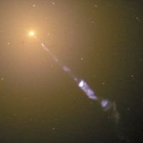
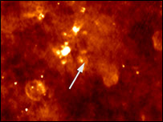
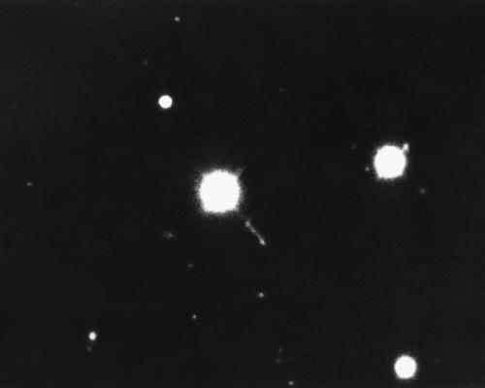
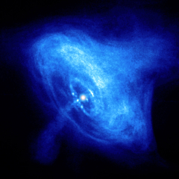
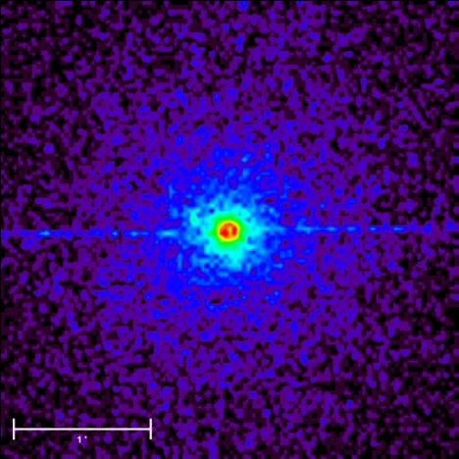
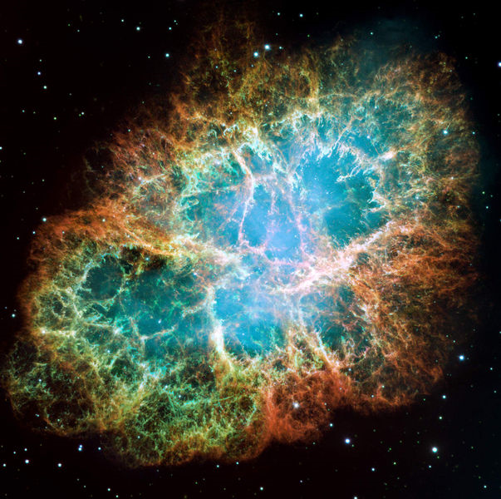
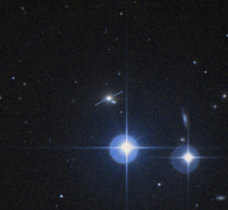
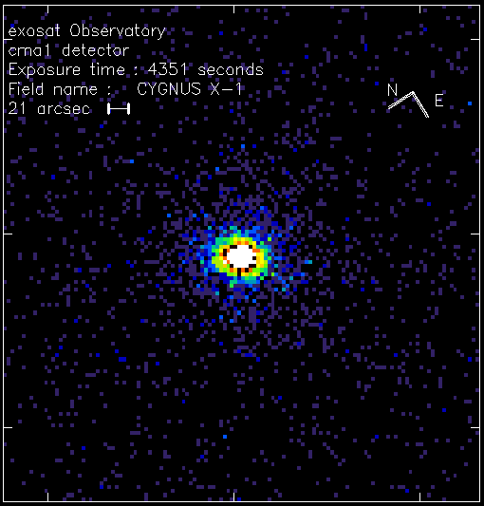

Potential Neutrino Sources
Magnetar SGR 1806-20
nearby AGN M87 (HST)
Quasar 3C273 Kitt Peak
Crab nebula SNR
Cygnus X-3 x-ray (Chandra)
Microquasar SS433 (VLBA)
BL Lac Markarian 421
Cygnus X-1

Slide 7
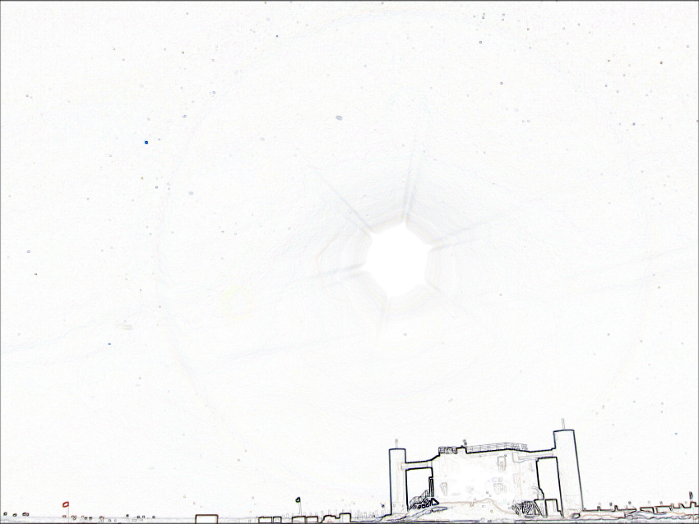
Telescopes
Helps you see things more clearly by improving your power of “sight”
Traditional telescopes use visible light
We can also “see” in other frequencies: infrared, radio, X-ray…
We can “see” with particles: Electron microscopes
Telescopes are directional
Notes:
IceCube is a Neutrino Telescope
What does telescope mean?

Slide 8
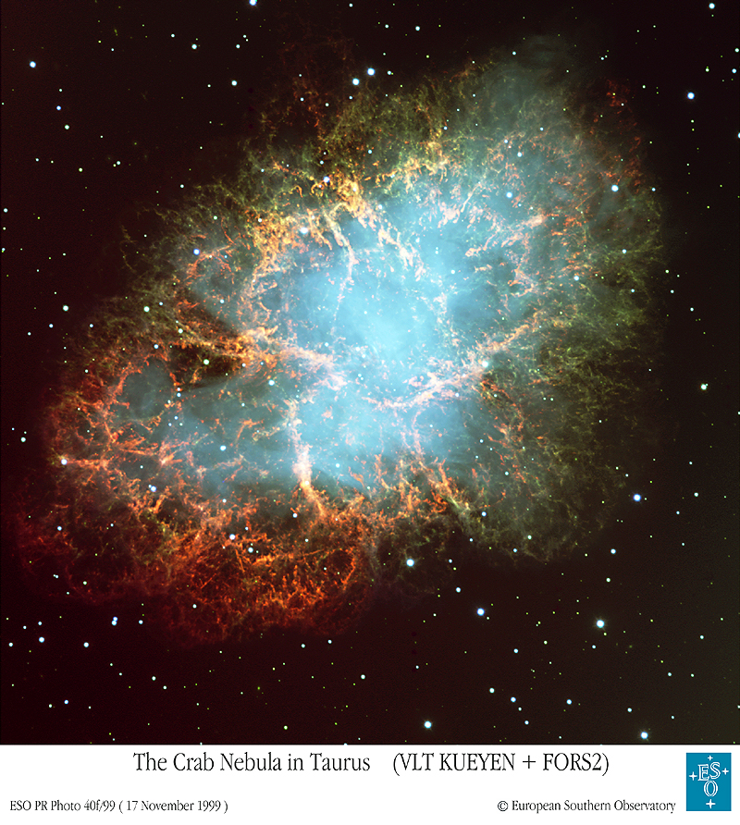
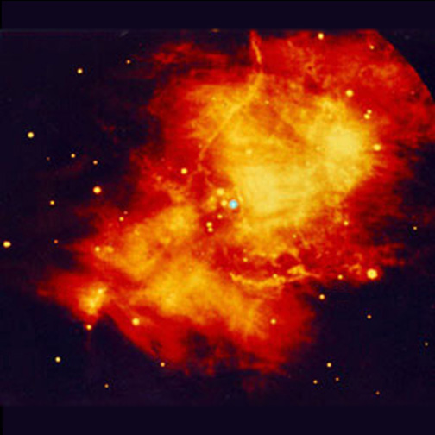
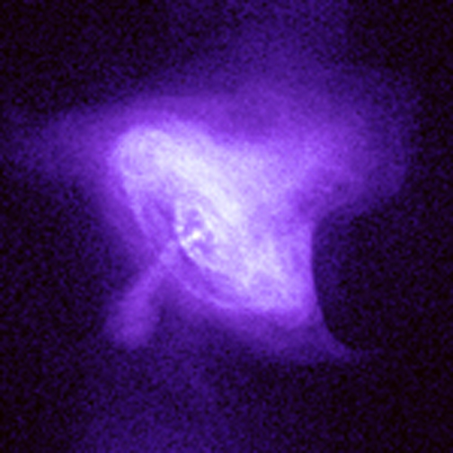
Crab Nebula through the eyes of different telescopes
Visible
Infrared
X-rays
Neutrinos
?
Notes:
Different ways of looking at something can give different information
The X-ray image show some structure in the nebula that the other images do not

Slide 9
Telescope | User | Date | Intended Use | Discovery
Optical | Galileo | 1608 | Navigation | Moons of Jupiter
Optical | Hubble | 1929 | Nebulae | Expanding Universe
Radio | Jansky | 1932 | Noise | Radio Galaxies
Microwave | Penzias & Wilson | 1965 | Radio galaxies, noise | 3K cosmic background
X-ray | Gicacconi et. al. | 1965 | Sun, moon | Neutron Stars, accreting binaries
Radio | Hewish, Bell | 1967 | Ionosphere | Pulsars
γ-rays | Military | 1960(?) | Thermonuclear explosions | Gamma Ray Bursts
Moral of the story: expect the unexpected . . .

Slide 10
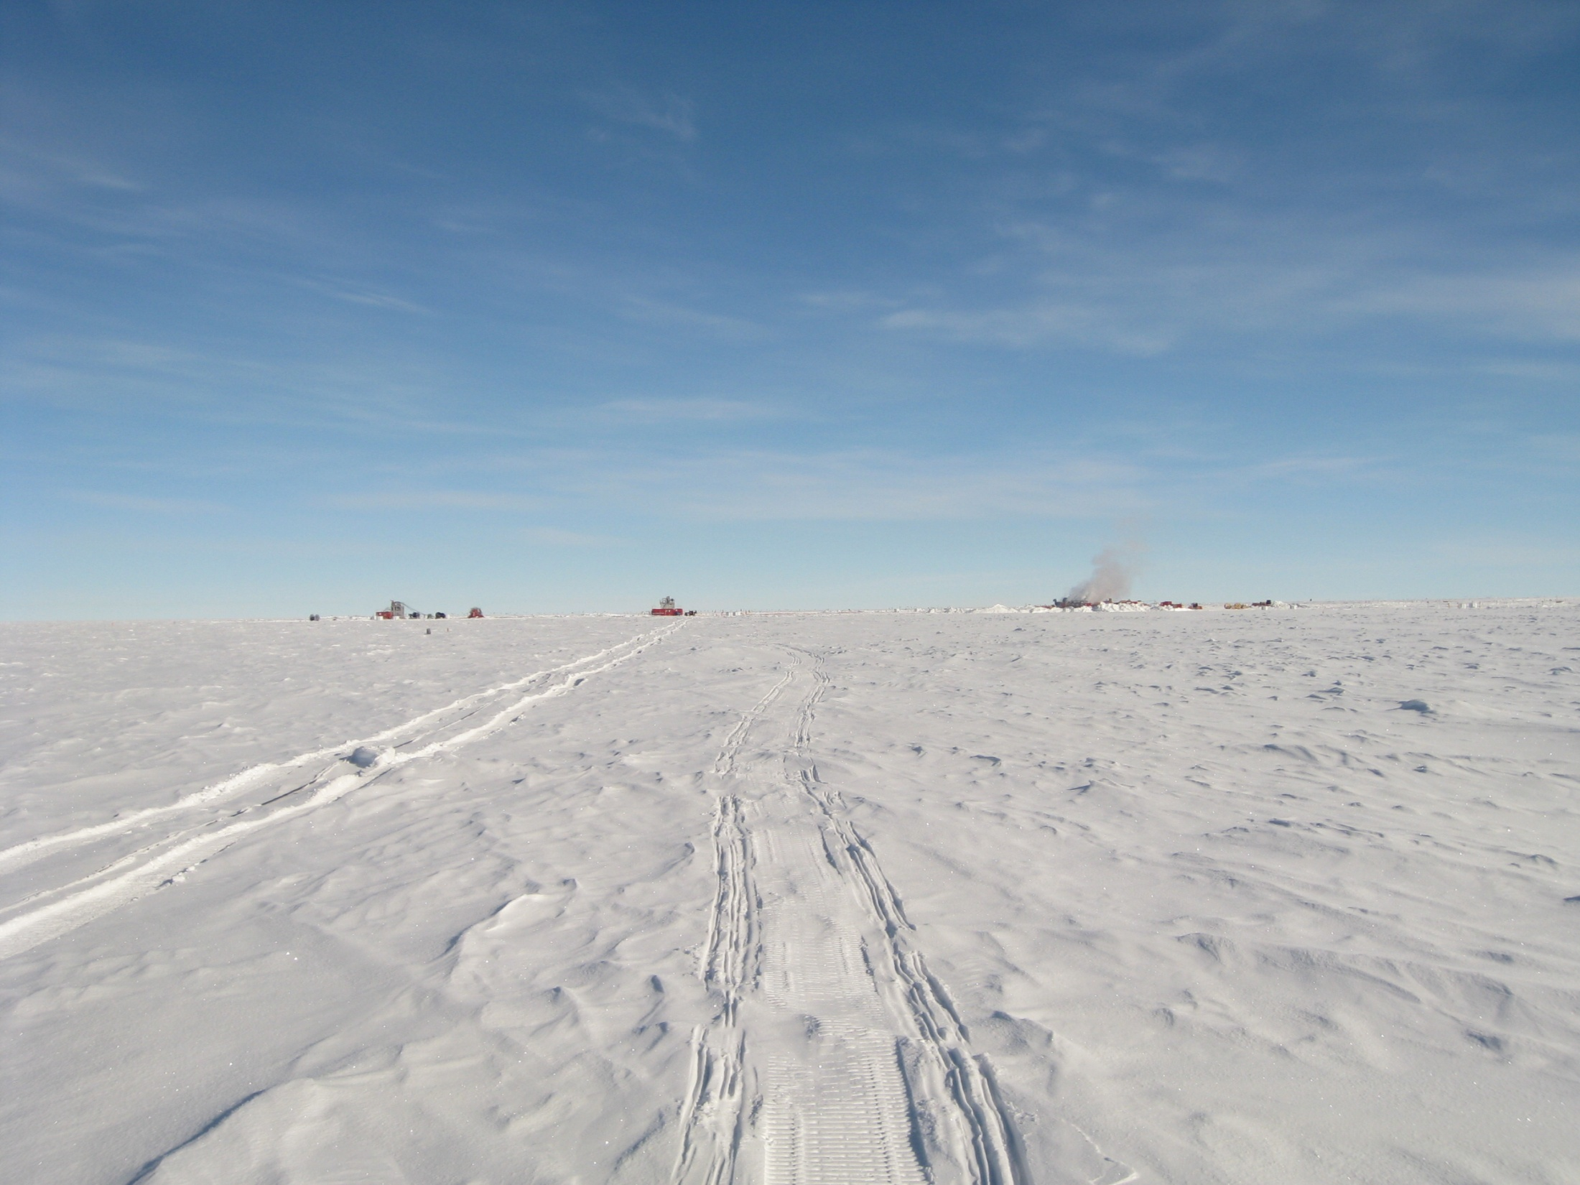
Fun Neutrino Facts
Each second, 50 trillion neutrinos go through your body
The 20mg of Potassium 40 in your body emits about 340M neutrinos per day
A hundred light years thickness of lead, on average, would stop a single neutrino
Hard, hard, hard to catch these buggers….

Slide 11
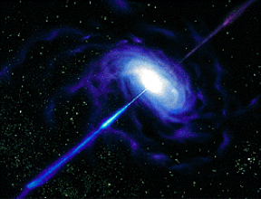

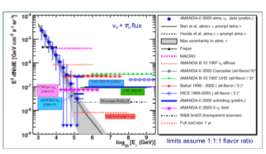



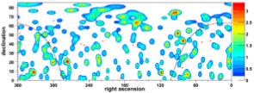




The IceCube Neutrino Observatory - A Wealth of Science...
AGNs, p+
accelerators
GRBs
γ
γ
Diffuse Sources
χχ
+ Advances in Glaciology
Point Sources
χ
Dark Matter
Supernovae
GZK/UHE
Cosmic Rays/Atm. Neurinos/Exotics
Notes:
Here I show the primary astrophysics topics for which IceCube was designed to search.

Slide 12

Detector Concept
1 km³ array of optical sensors deployed throughout ice
detect cerenkov radiation from “debris” of neutrino collision
use time-of-arrival in all sensors to reconstruct direction
–> astronomy

Slide 13
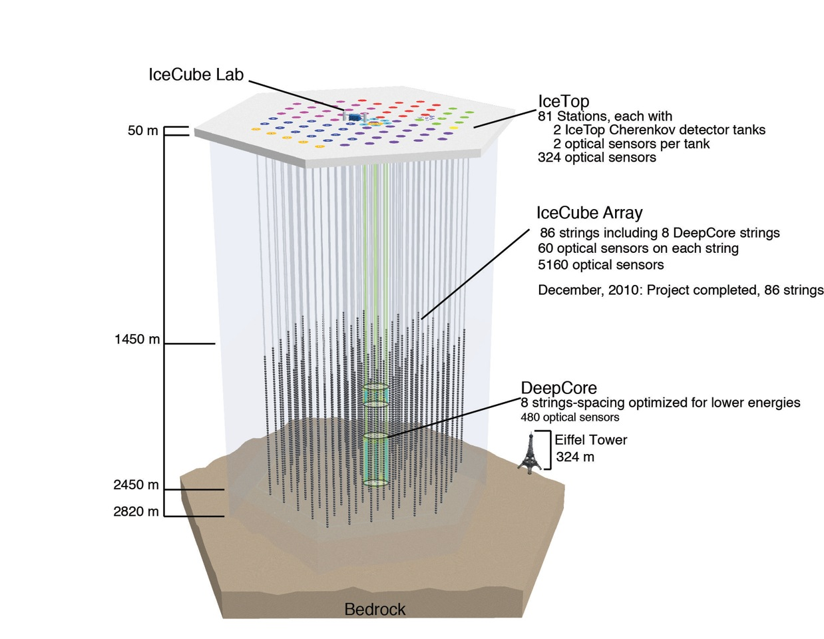
IceCube at South Pole
Drill sequence
2004-05 1 1
2005-06 8 9
2006-07 13 22
2007-08 18 40
2008-09 19 59
2009-10 20 79
2010-11 7 86

Slide 14
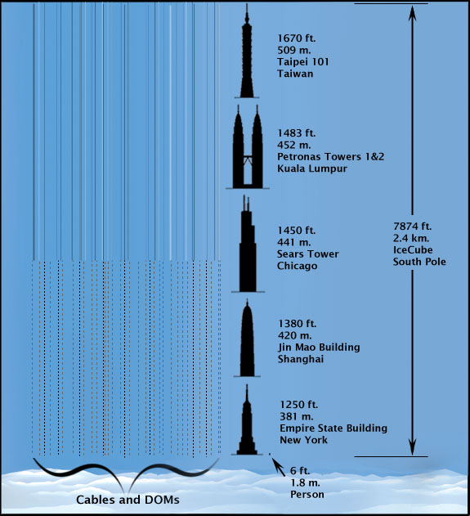
New analogy: This volume would fit about 350 Lambeau Fields!

Slide 15
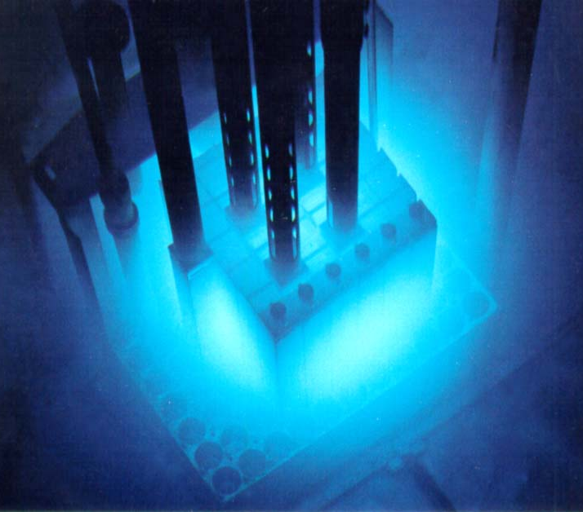
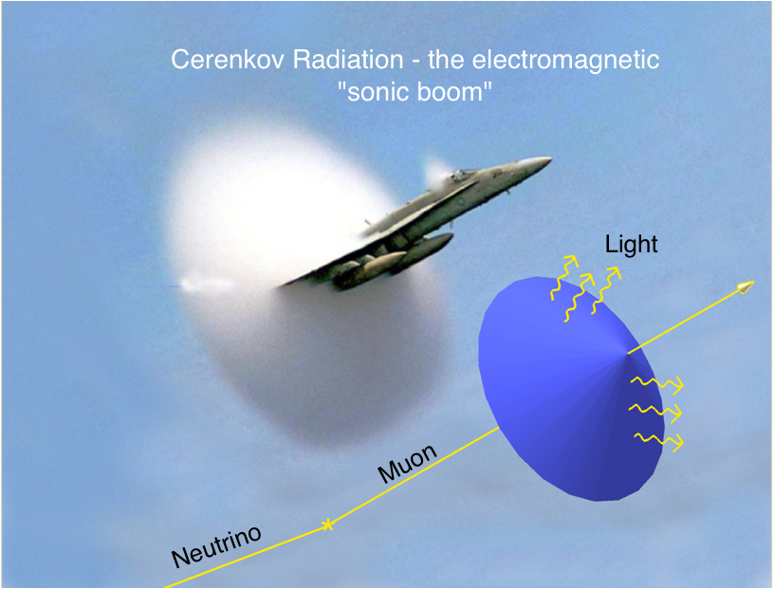
The IceCube Neutrino Observatory - Principle of Operation
Cherenkov light in a reactor

Slide 16
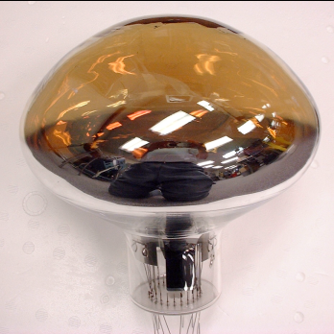
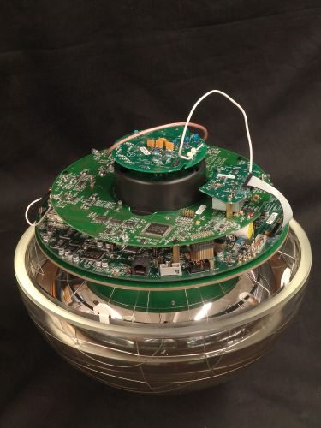
Sensing Neutrino Light
IceCube “Digital Optical Module” (DOM)
Power consumption: 3W
Hamamatsu 10 inch PMT
Measure arrival time of every photon
2x 300MHz waveform digitizers
1x 40 MHz FADC digitizer
Can trigger in coincidence w/ neighbor DOM
Transmits data to surface on request
Data sent over 3.3 km twisted pair copper cable
Knows the time to within 3 nanoseconds to all other DOMs in the ice
Main board
PMT base
Clock stability: 10⁻¹⁰ ≈ 0.1 nsec / sec
Synchronized periodically to precision of O(2 nsec)
33 cm Benthosphere

Slide 17
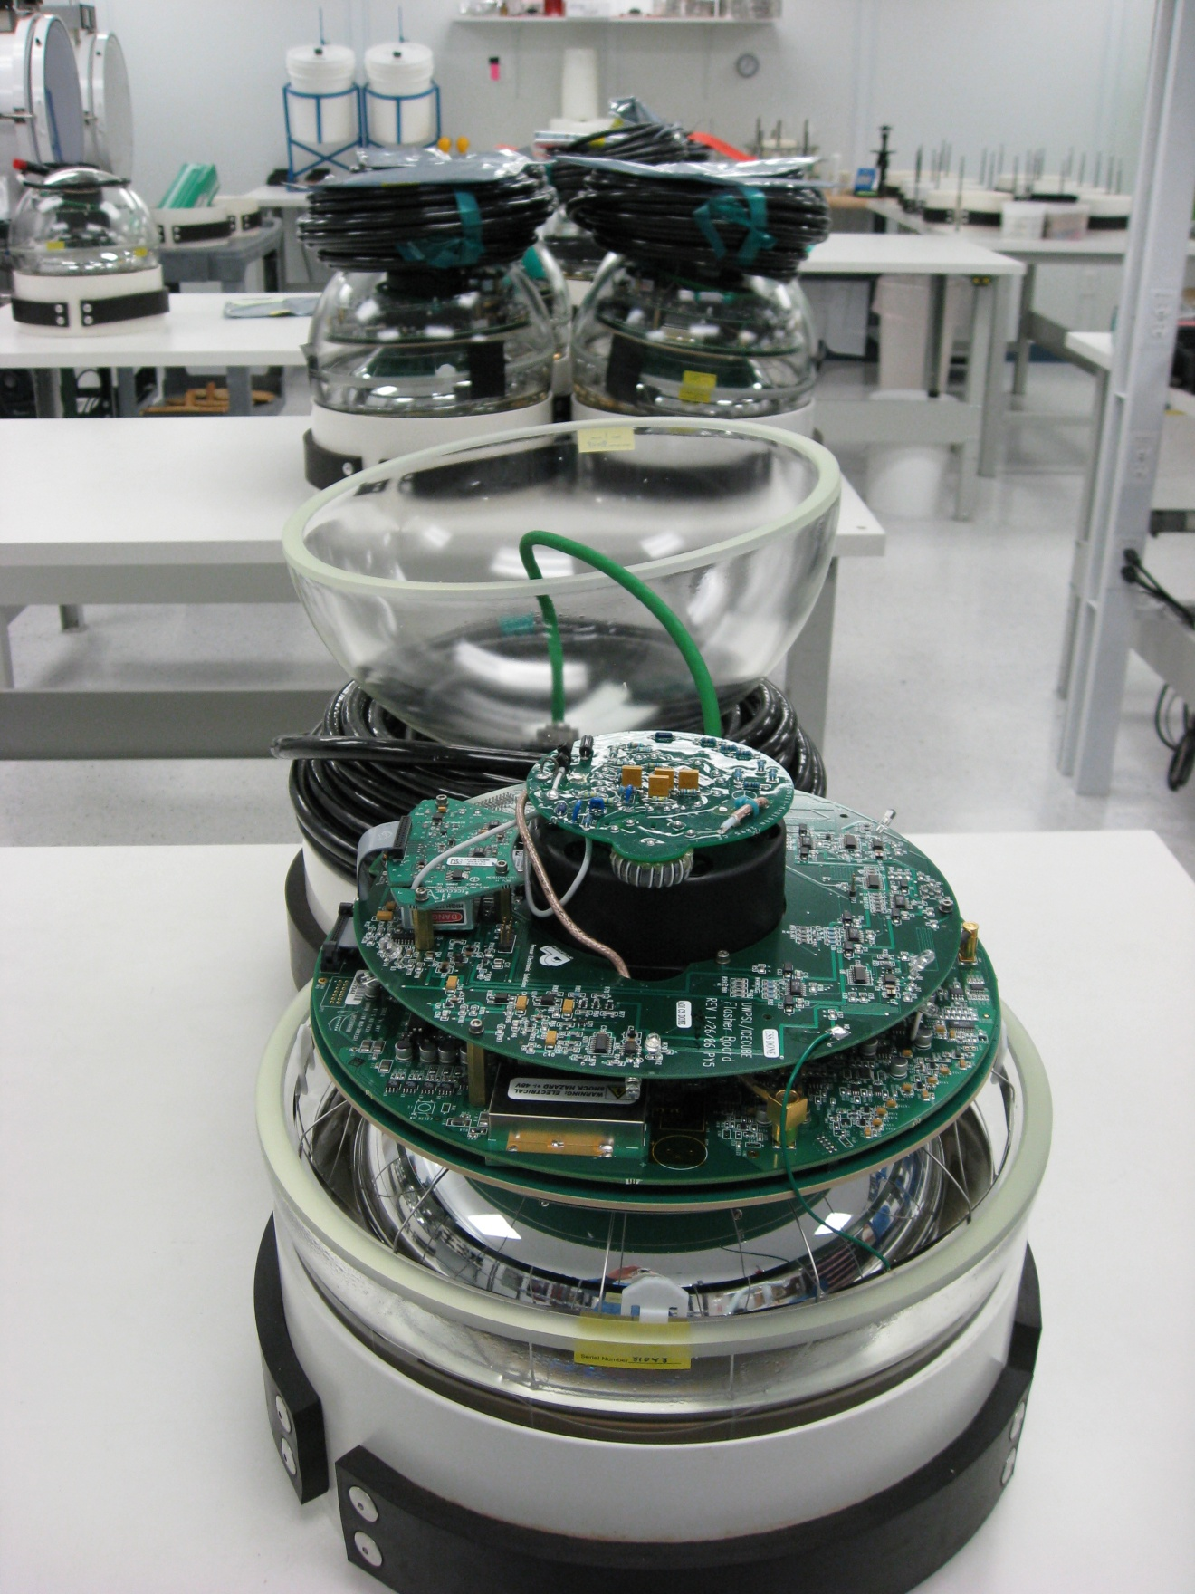

Slide 18
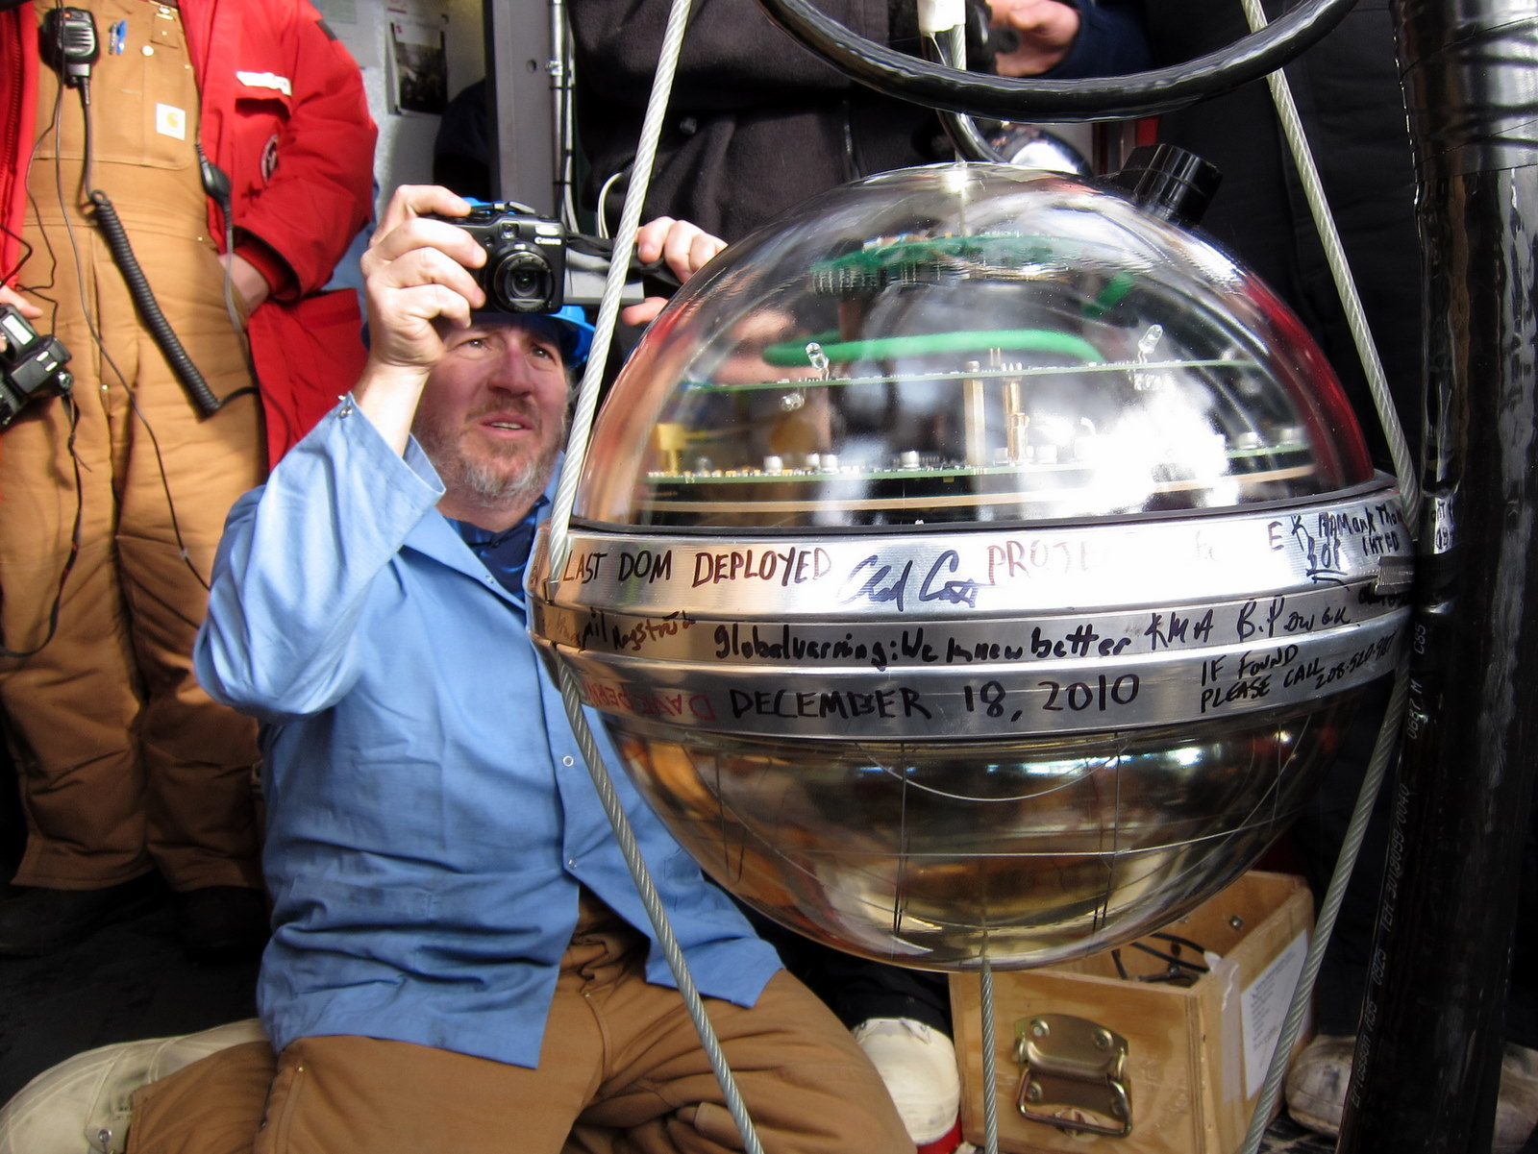
> 98% deployed are working in-ice

Slide 19
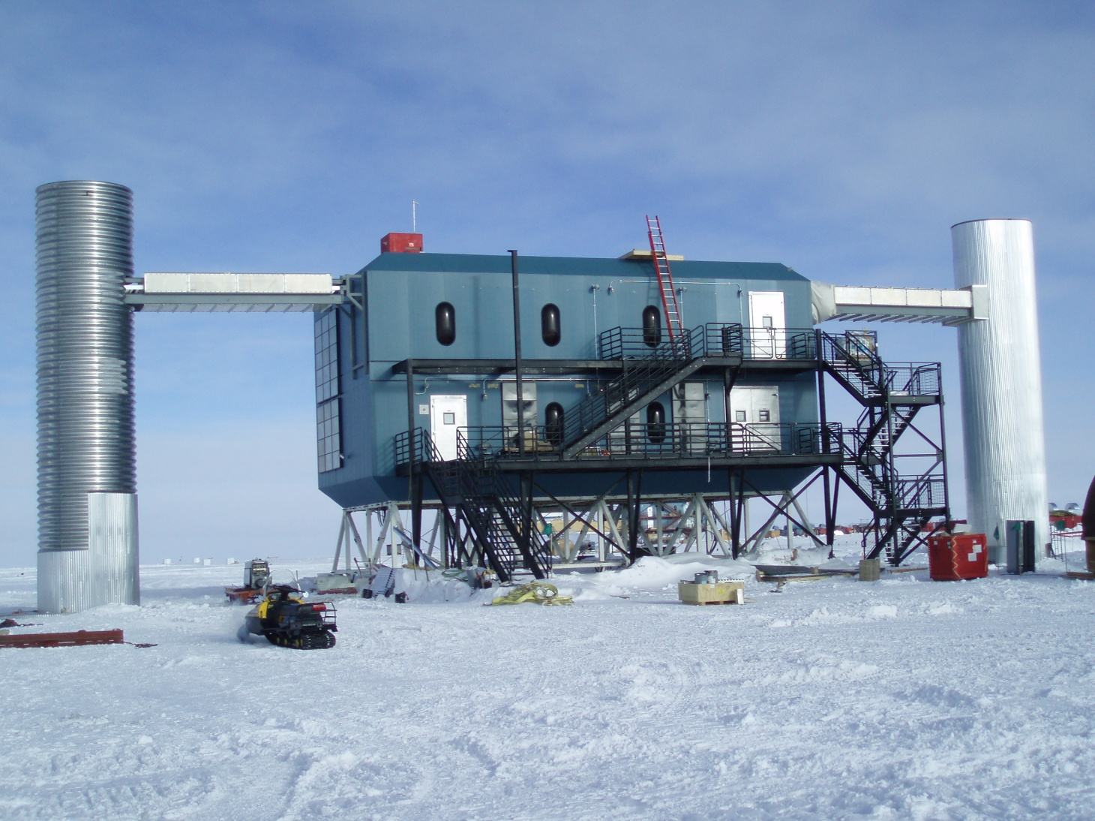
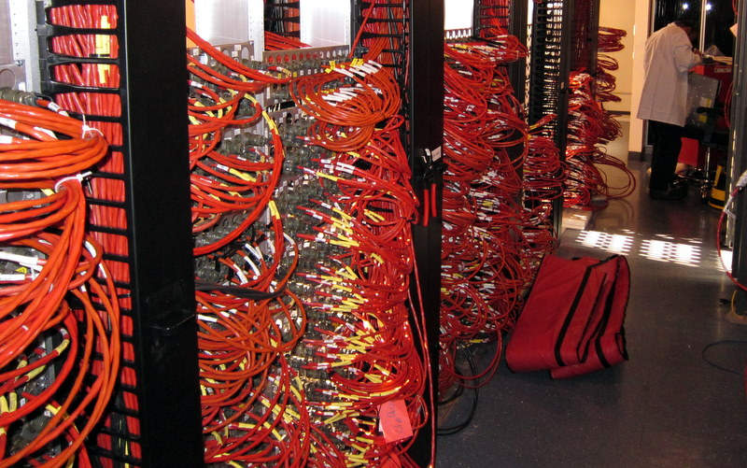
IceCube
Surface Hardware
Initiate runs and monitor detector from North
Filtered data sent by satellite
17 racks of computers
Power: 60 kW total for full IceCube
19

Slide 20
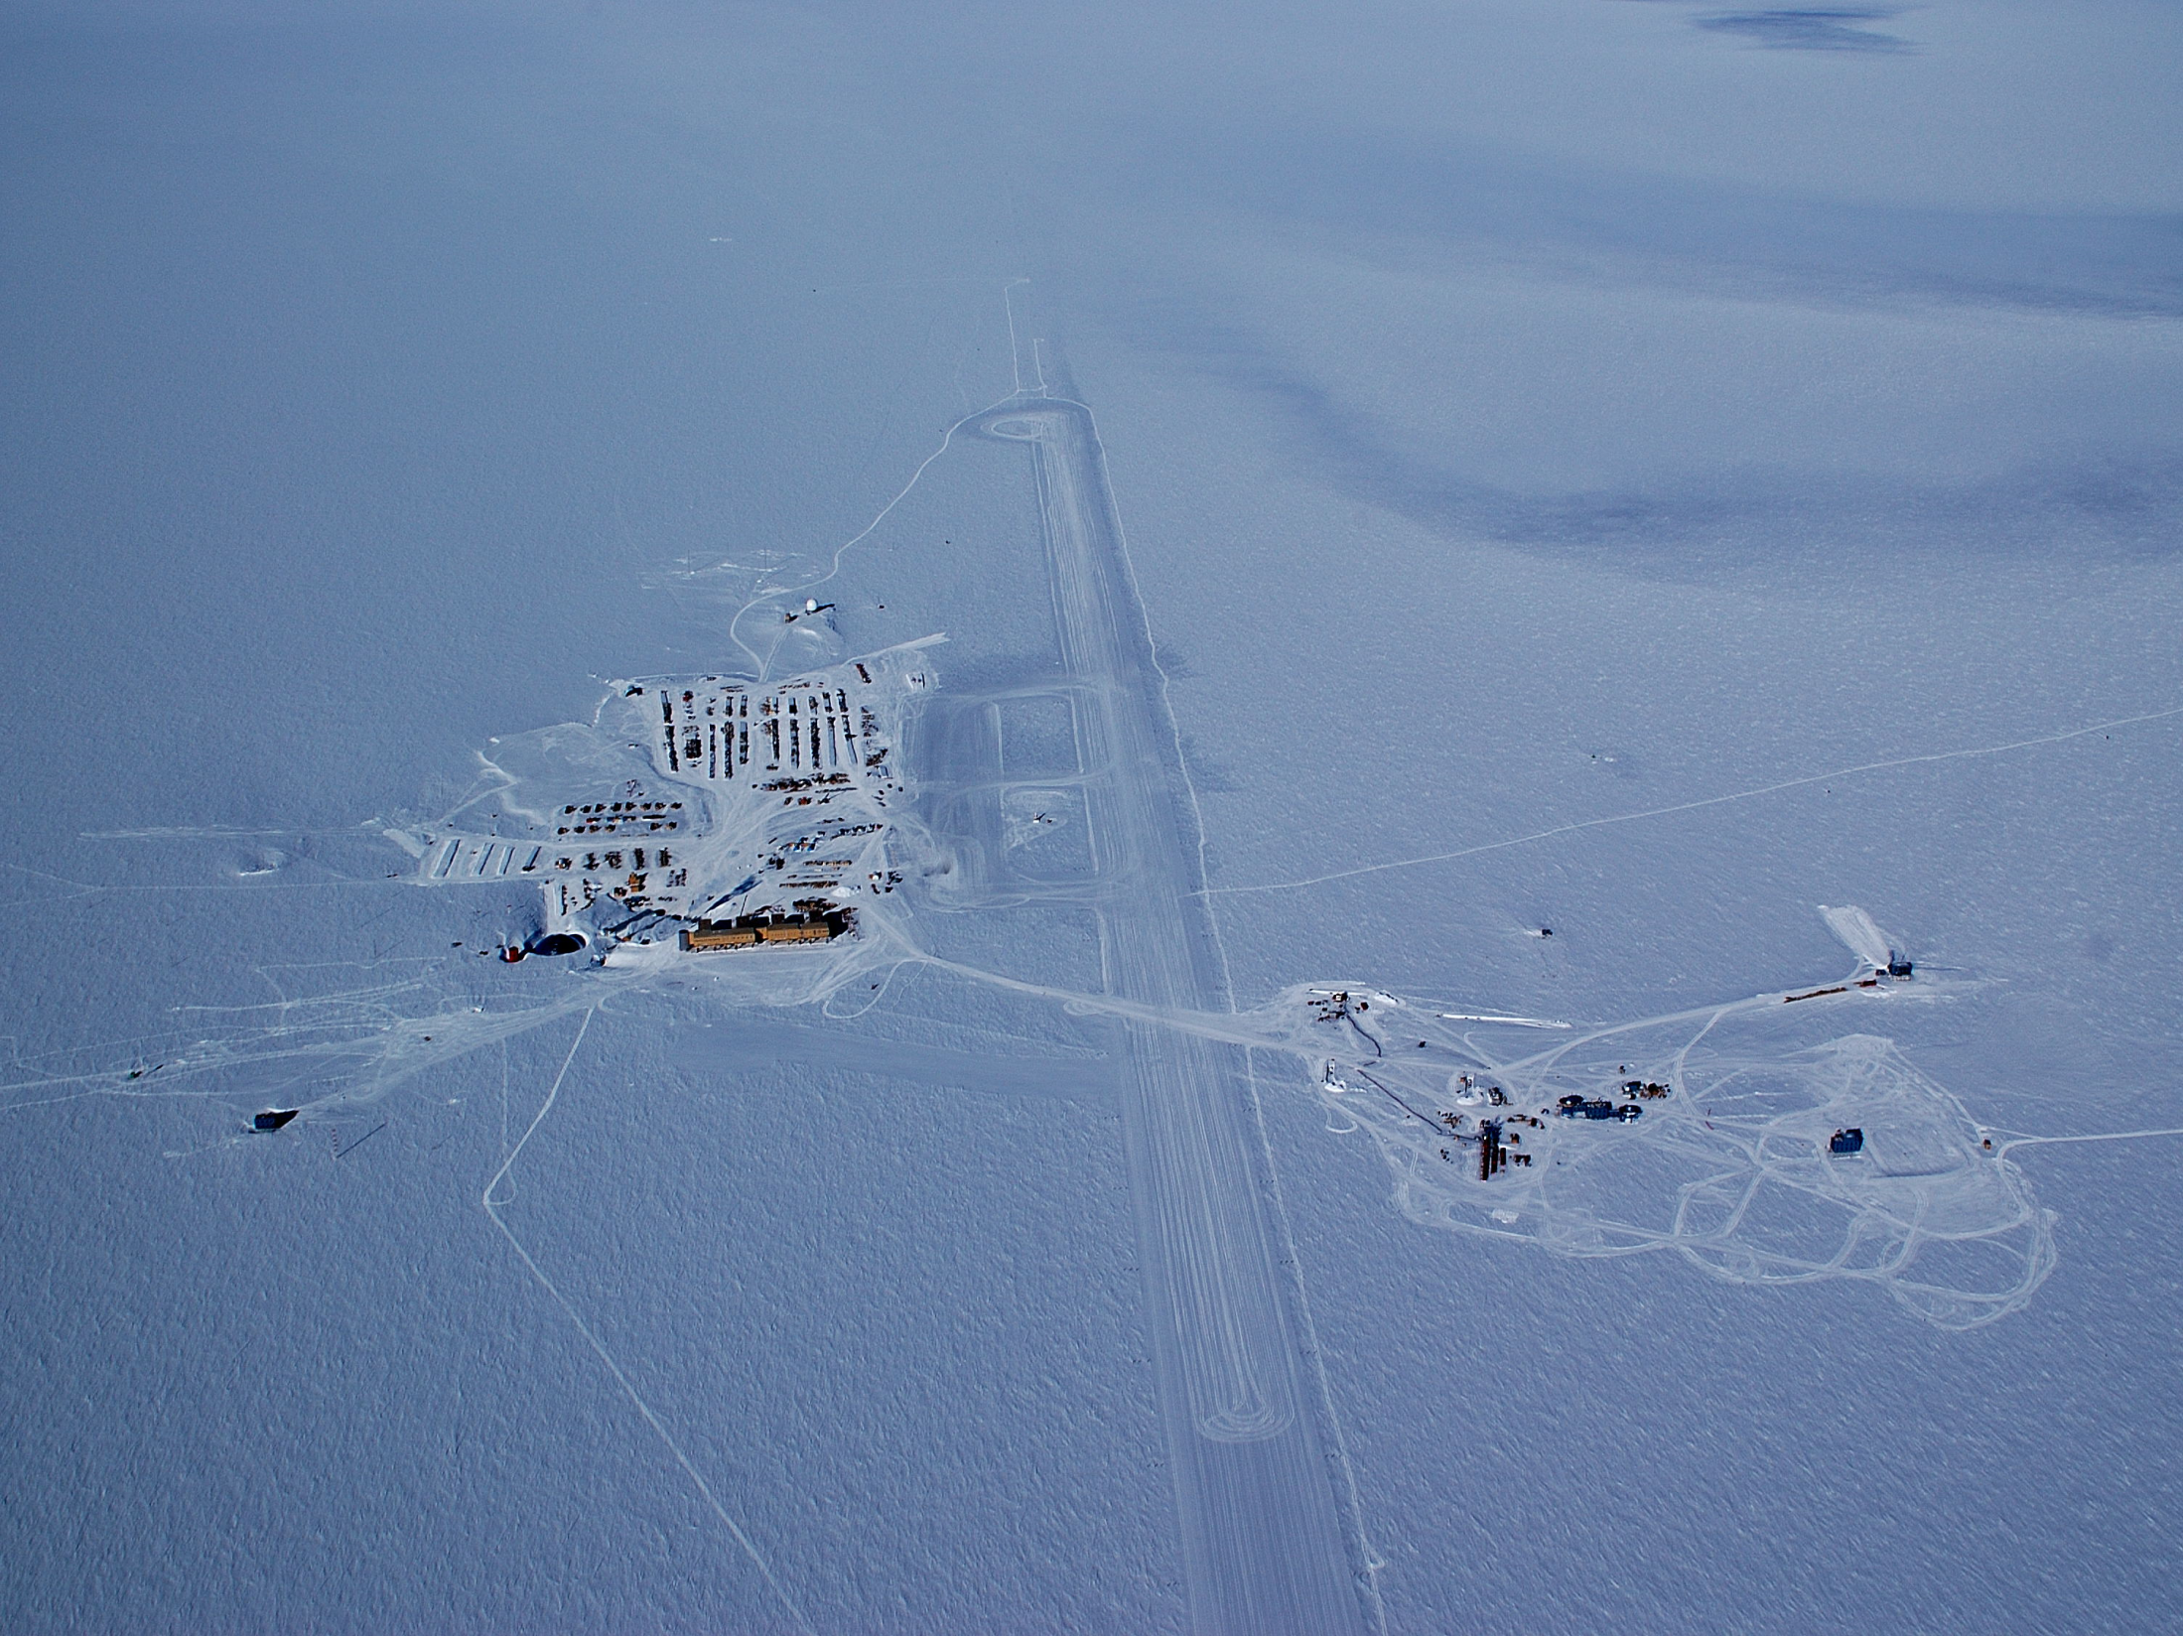
South Pole with IceCube
Getting IceCube in the Ice
The Enhanced Hot Water Drill and the DOM deployment process
IceCube

Slide 21
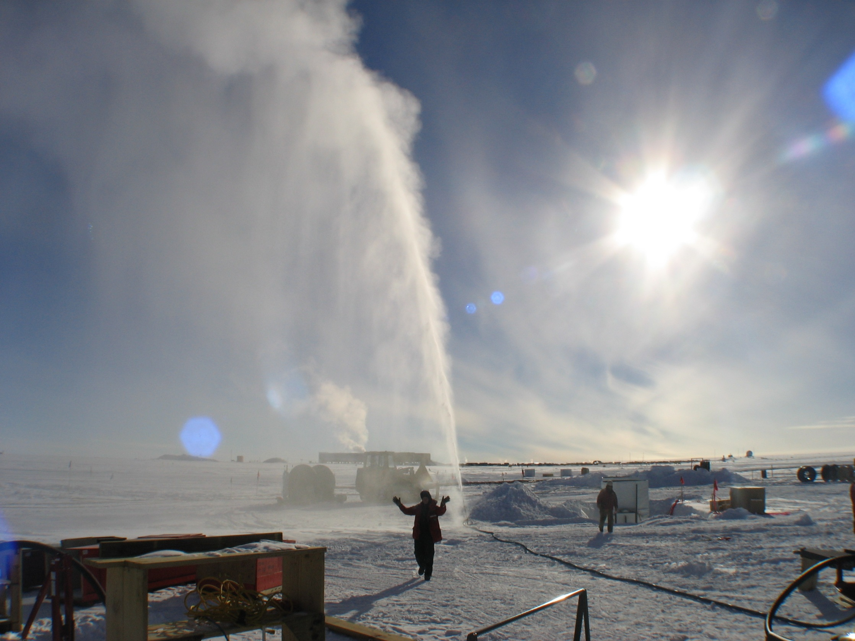
Why a Hot Water Drill?
Hot water + Ice = Hole
Fast
Need a water-filled hole
  DOMs freeze in and become optically coupled with ice sheet
  Fluid supports hole so it doesn’t collapse in on itself
  Allows us to circulate water

Slide 22
How Much Hot Water?
Enough to melt…
86 holes, each 60 cm (24 in) in diameter and 2.5 km (1.6 miles) deep
  Instrumented volume of IceCube is between depths of 1450 and 2450 meters
200,000 gallons of ice per hole
17.2 million gallons of ice total!

Slide 23
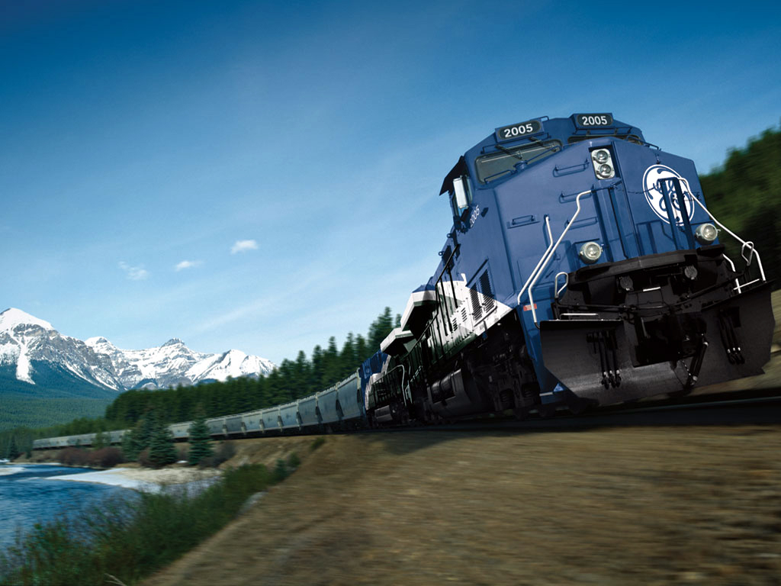
Drill Stats
IceCube has delivered ~9.5 million lbs to SPole, half of which is fuel
The drill alone has accounted for nearly 1.2 million pounds of cargo (w/o fuel)
4.7 MW of thermal power output
  That’s 6300 horsepower
  Equivalent to a locomotive at full power, or…
  8 Nascars racing at full speed
  All this shot out of a ¾” nozzle!
Mileage = 1400 gallons of fuel per mile
We have drilled 86 holes, and have melted enough ice for 794 million cocktails!

Slide 24
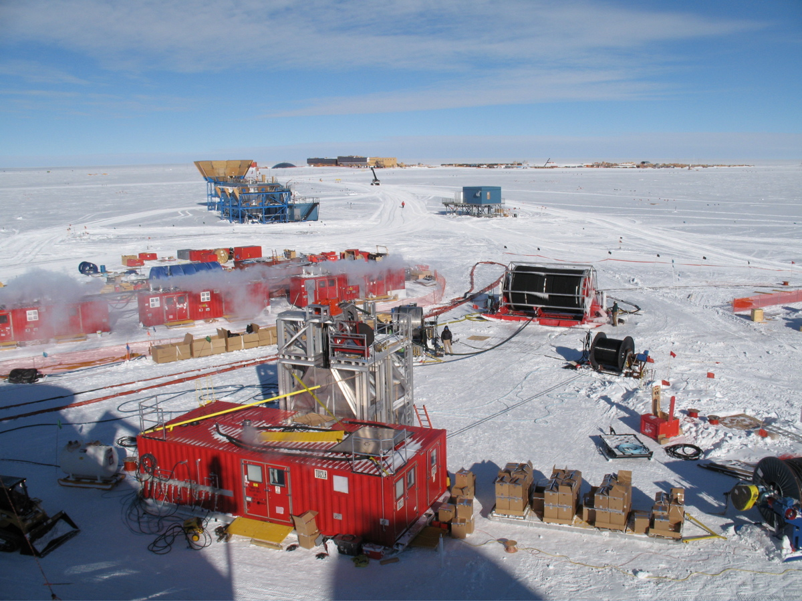
What is “the Drill” Exactly?

Slide 25
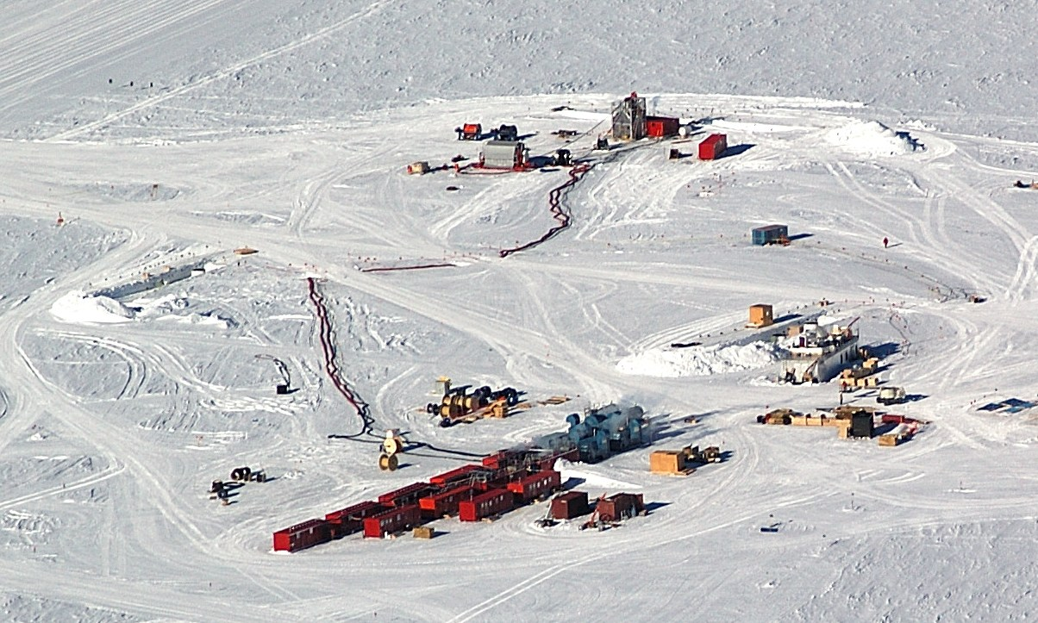
HOLE or TOWER SITE
DRILL CAMP
Notes:
Note person walking

Slide 26
Enhanced Hot Water Drill Hydraulic Summary
BP
PHS
MHP1
MHP3
VTP
WT2
HPP
CP
1-4
HPP
1-4
200 GPM, 88 degC, 950 psig (nominal)
VP1
VP2
RWS
MHP2
MHP4
TP1
TP2
WT1
RW
Rod
Well
VT1
VT2
DSHR
Generators
BP - Booster Pump
CP - Charge Pump
HPP - High Pressure Pump
RW - Rodwell Pump
RWP - Return Water Pump
TP – Transfer Pump
VP – Vane Pump (not in service)
VTP, VT - Vertical Turbine Pump
Supply: 200 GPM at 1100 psi and 88°C (190°F)
Return: 185 GPM at 1°C (~33°F)
Make Up Water: 15 GPM at 1°C
Power: 4.7 MW thermal, 300 kW electrical
HOLE
Cold Water
Warm Water
Hot Water
Pump or Heater
MDS
Seasonal
Equipment
Site
Tower
Operations
Site
RWP

Slide 27
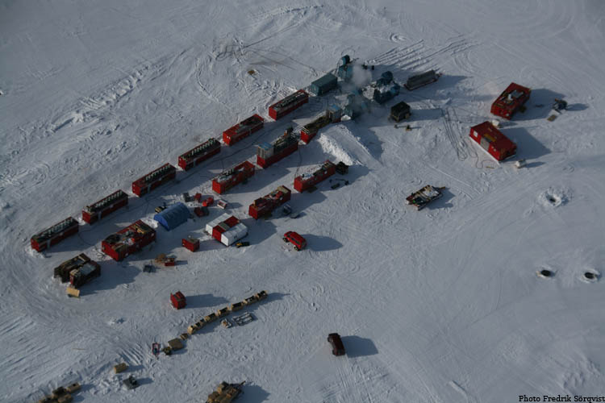
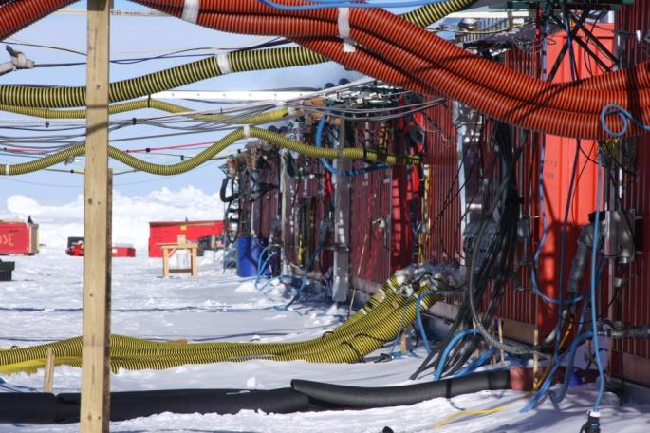
Seasonal Equipment Site (SES, Drill Camp)
Notes:
Note van

Slide 28
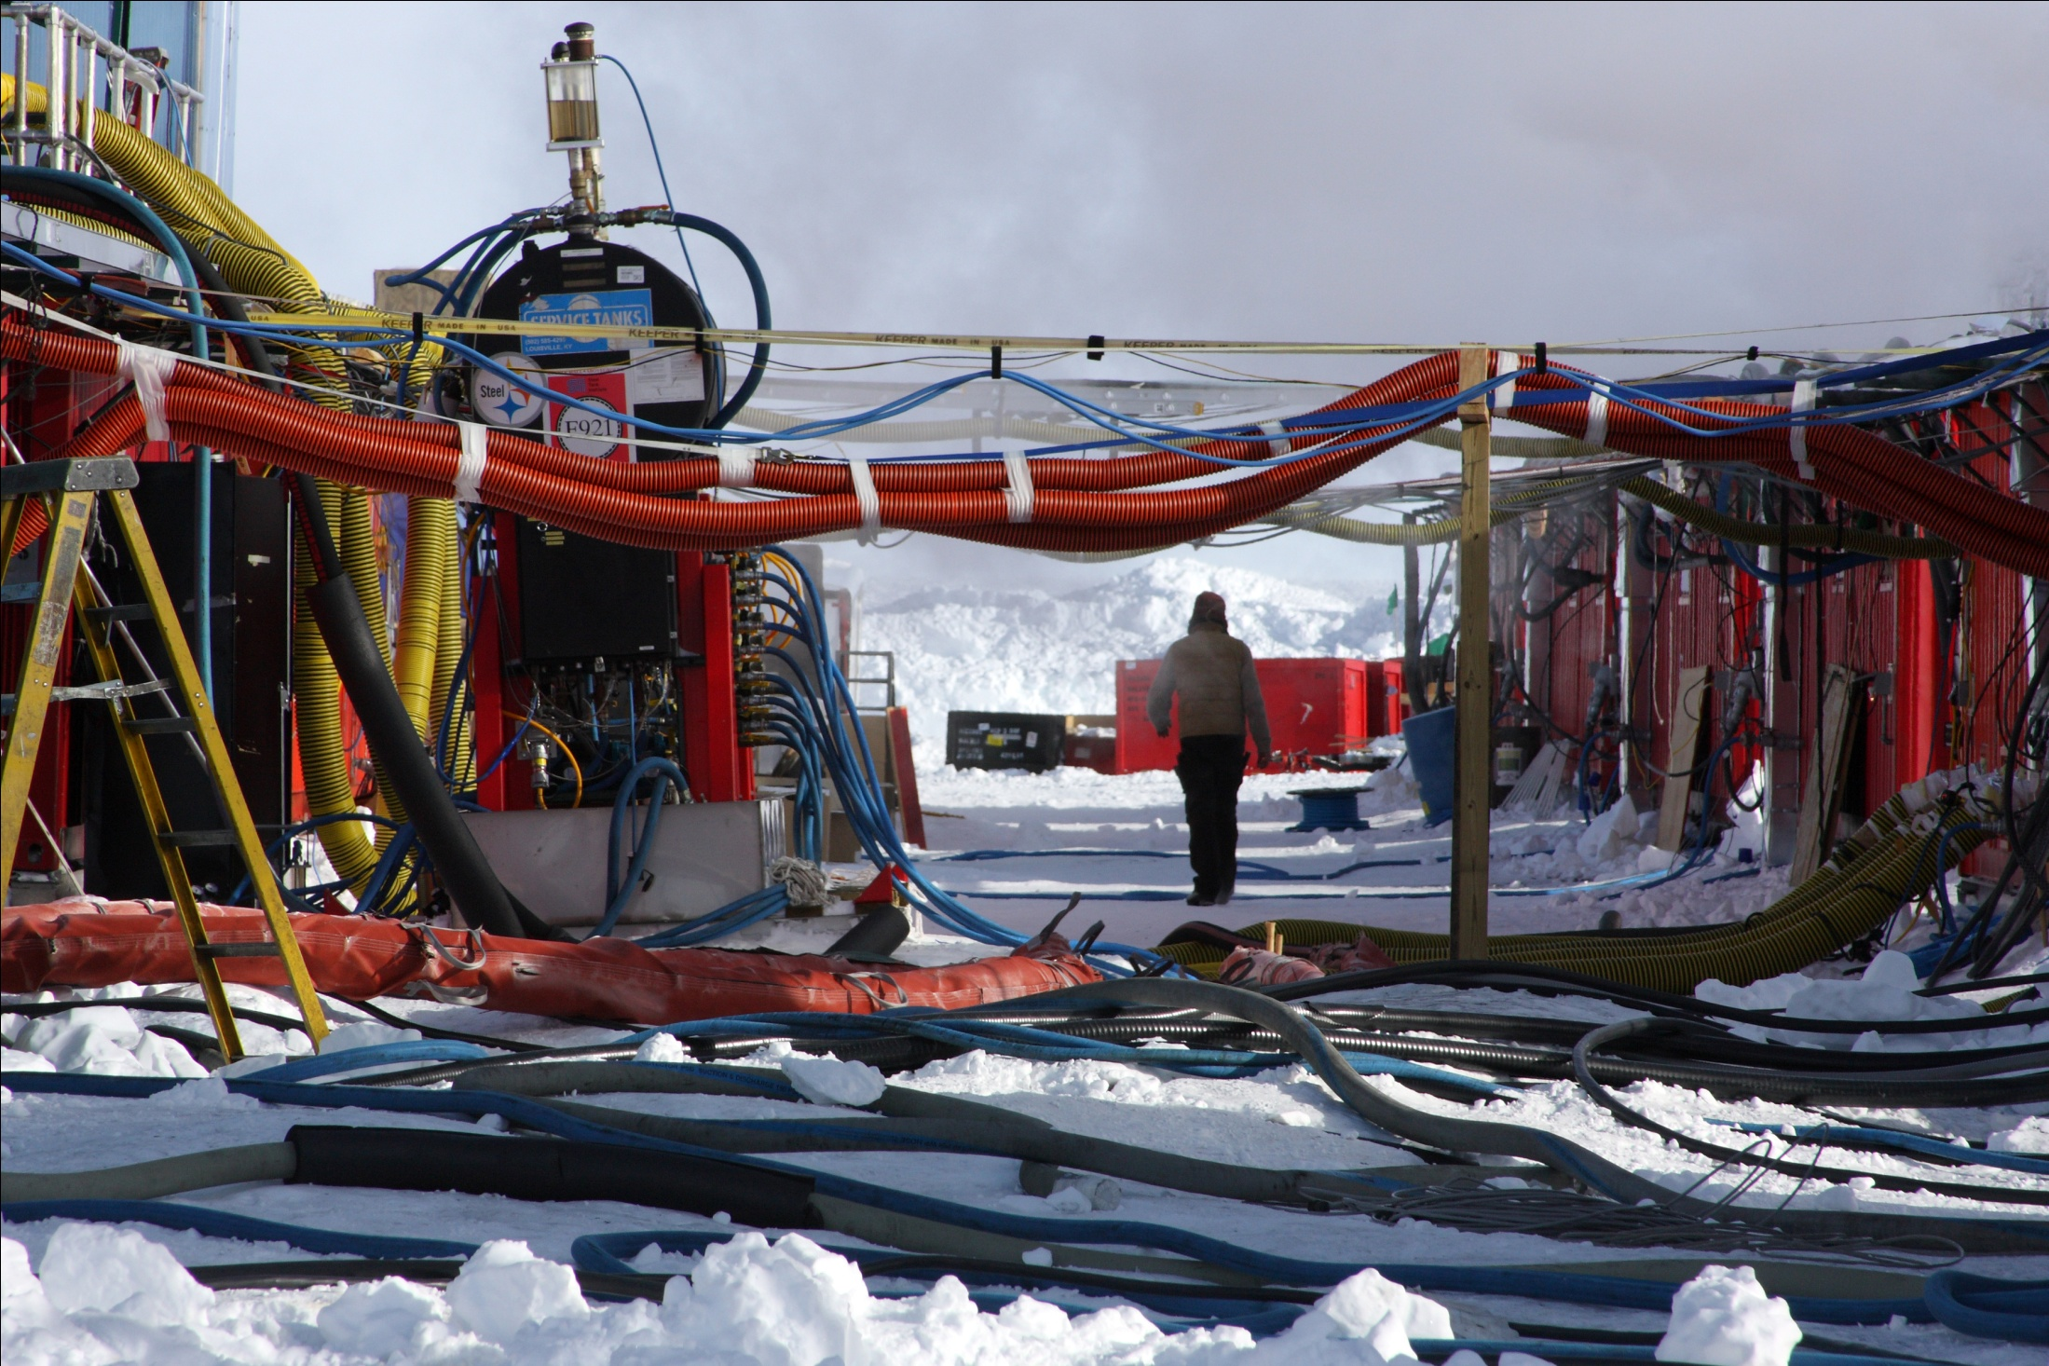

Slide 29
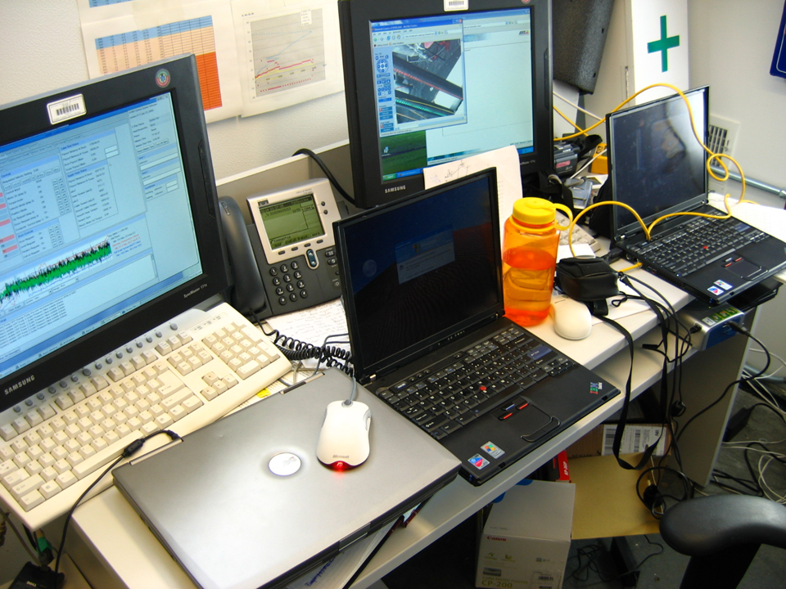
Some Notables – Control System
Advanced computer control system
Monitor flows, temps, pressures, environmental conditions, equipment performance
Except for some manual valves, most everything in the system can be controlled from the control system computers

Slide 30
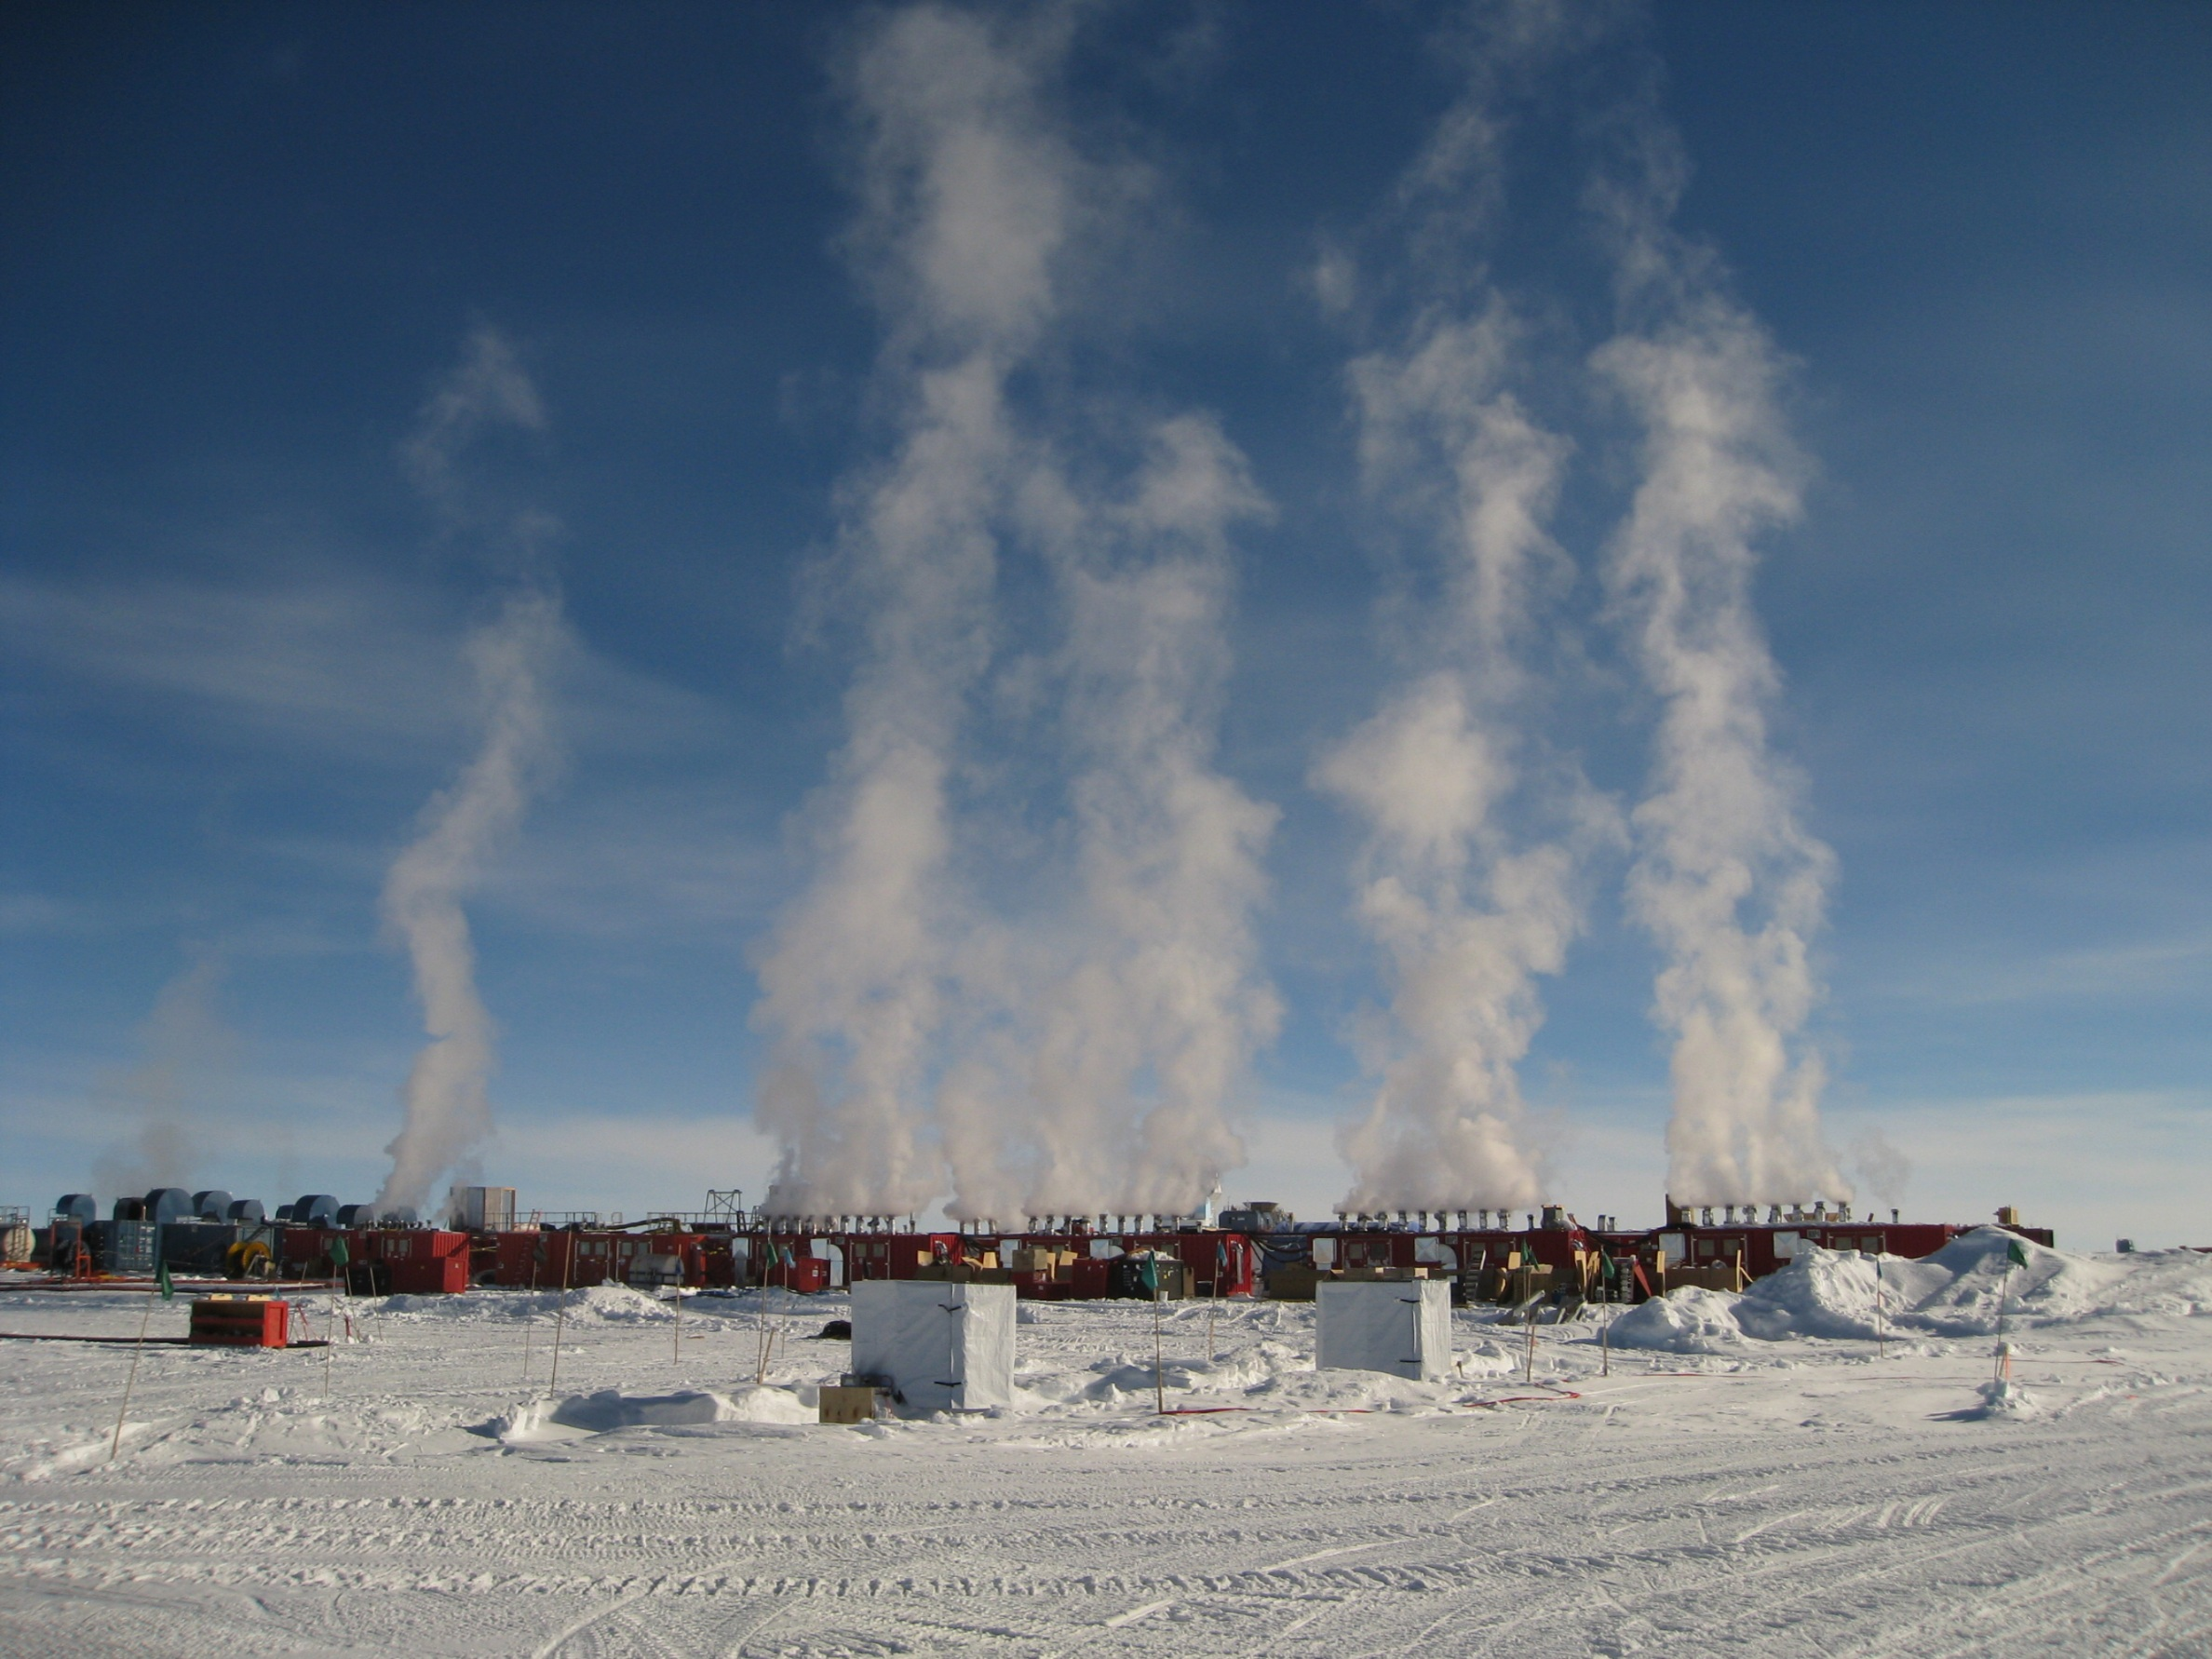

Slide 31
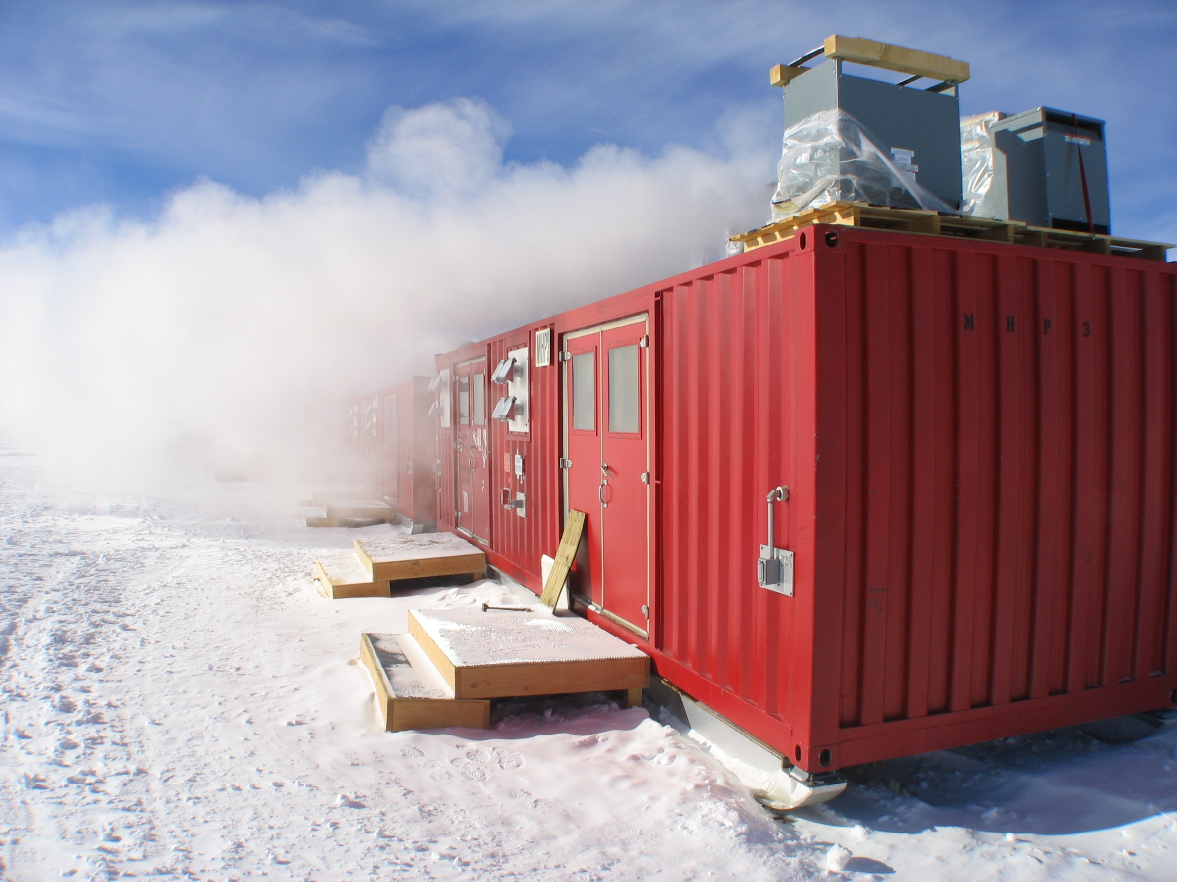

Slide 32
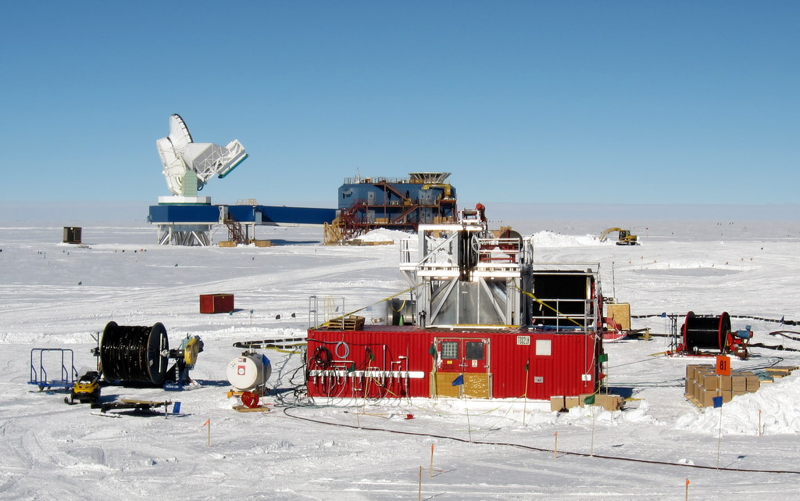
Tower Ops site with South Pole Telescope
Halo over drill camp, time to start drilling

Slide 33
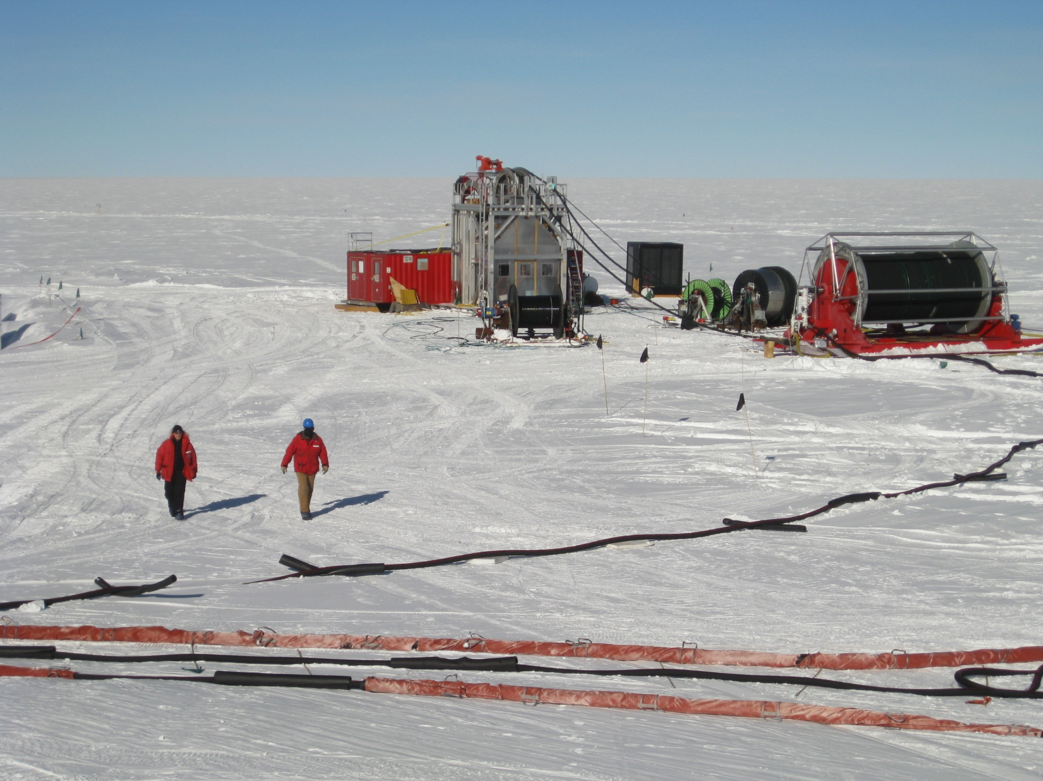
Tower Ops with Nothing in the background

Slide 34
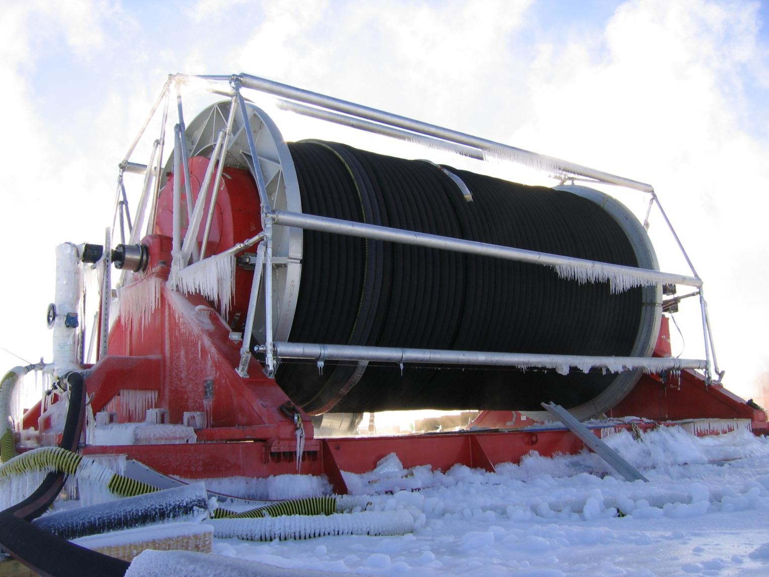
Some Notables - BRUCE
8400 feet of hose (21 x 400’ sections)
100,000 lbs when full of water

Slide 35
How Did It Do?
2004-2005: 1 (and a half) holes
depth
2009-2010: 20 holes
Notes:
04-05 not actual data, but representative

Slide 36
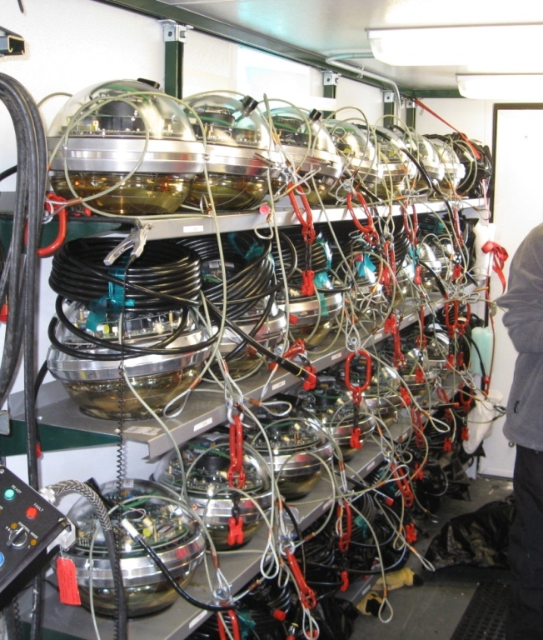
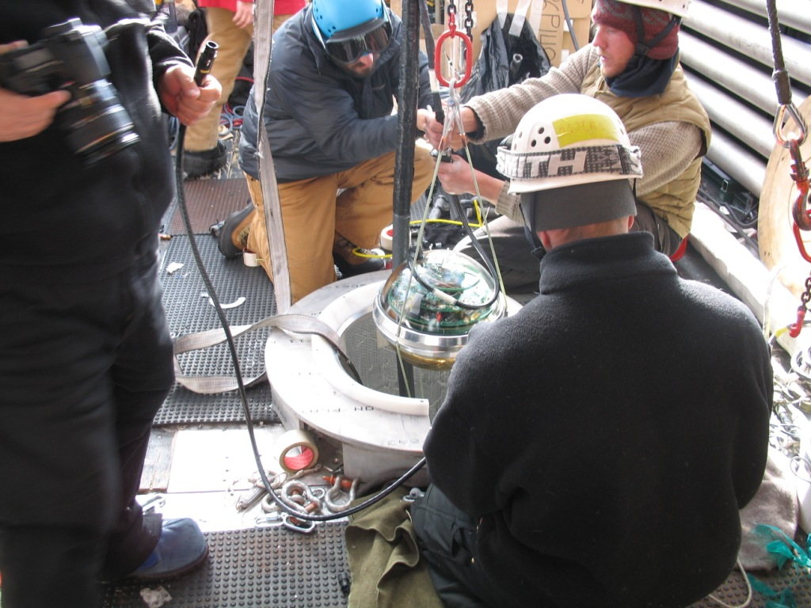
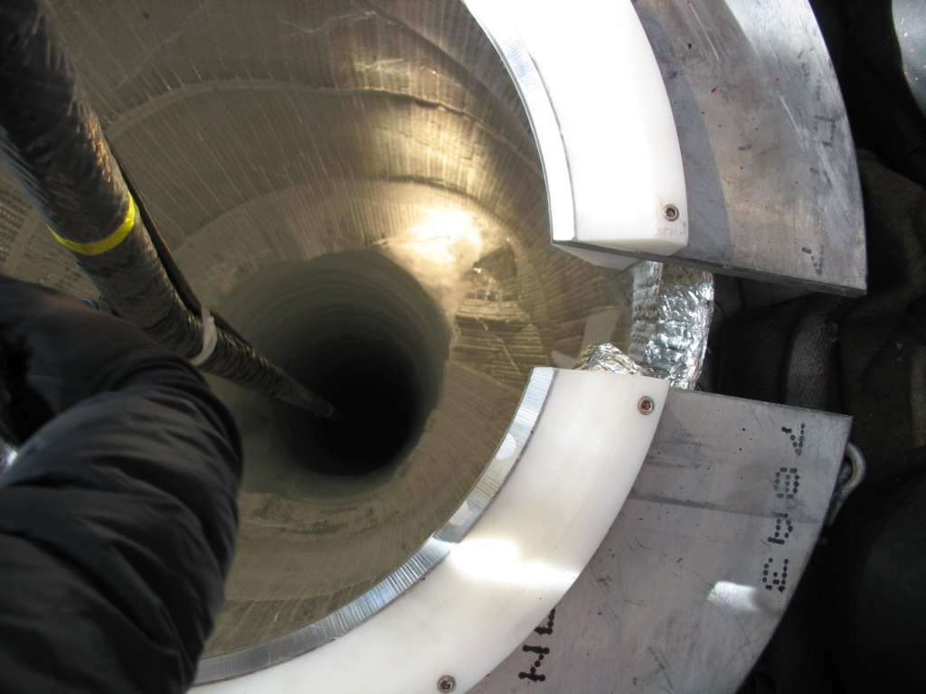
DOM deployment

Slide 37
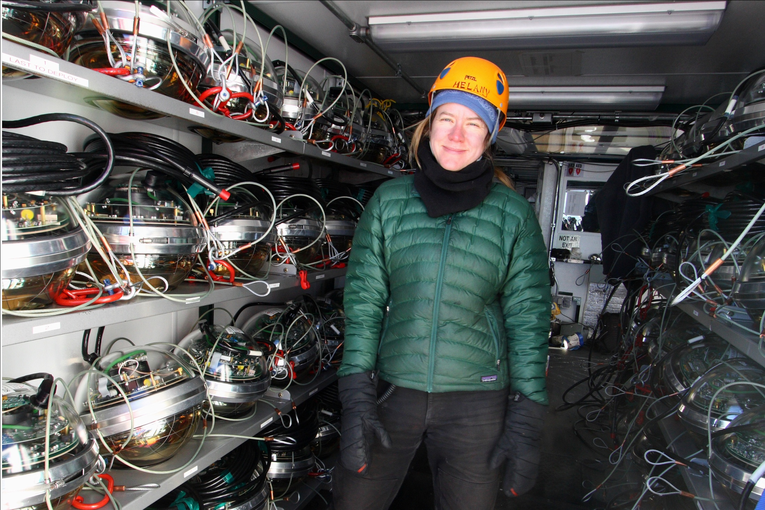

Slide 38
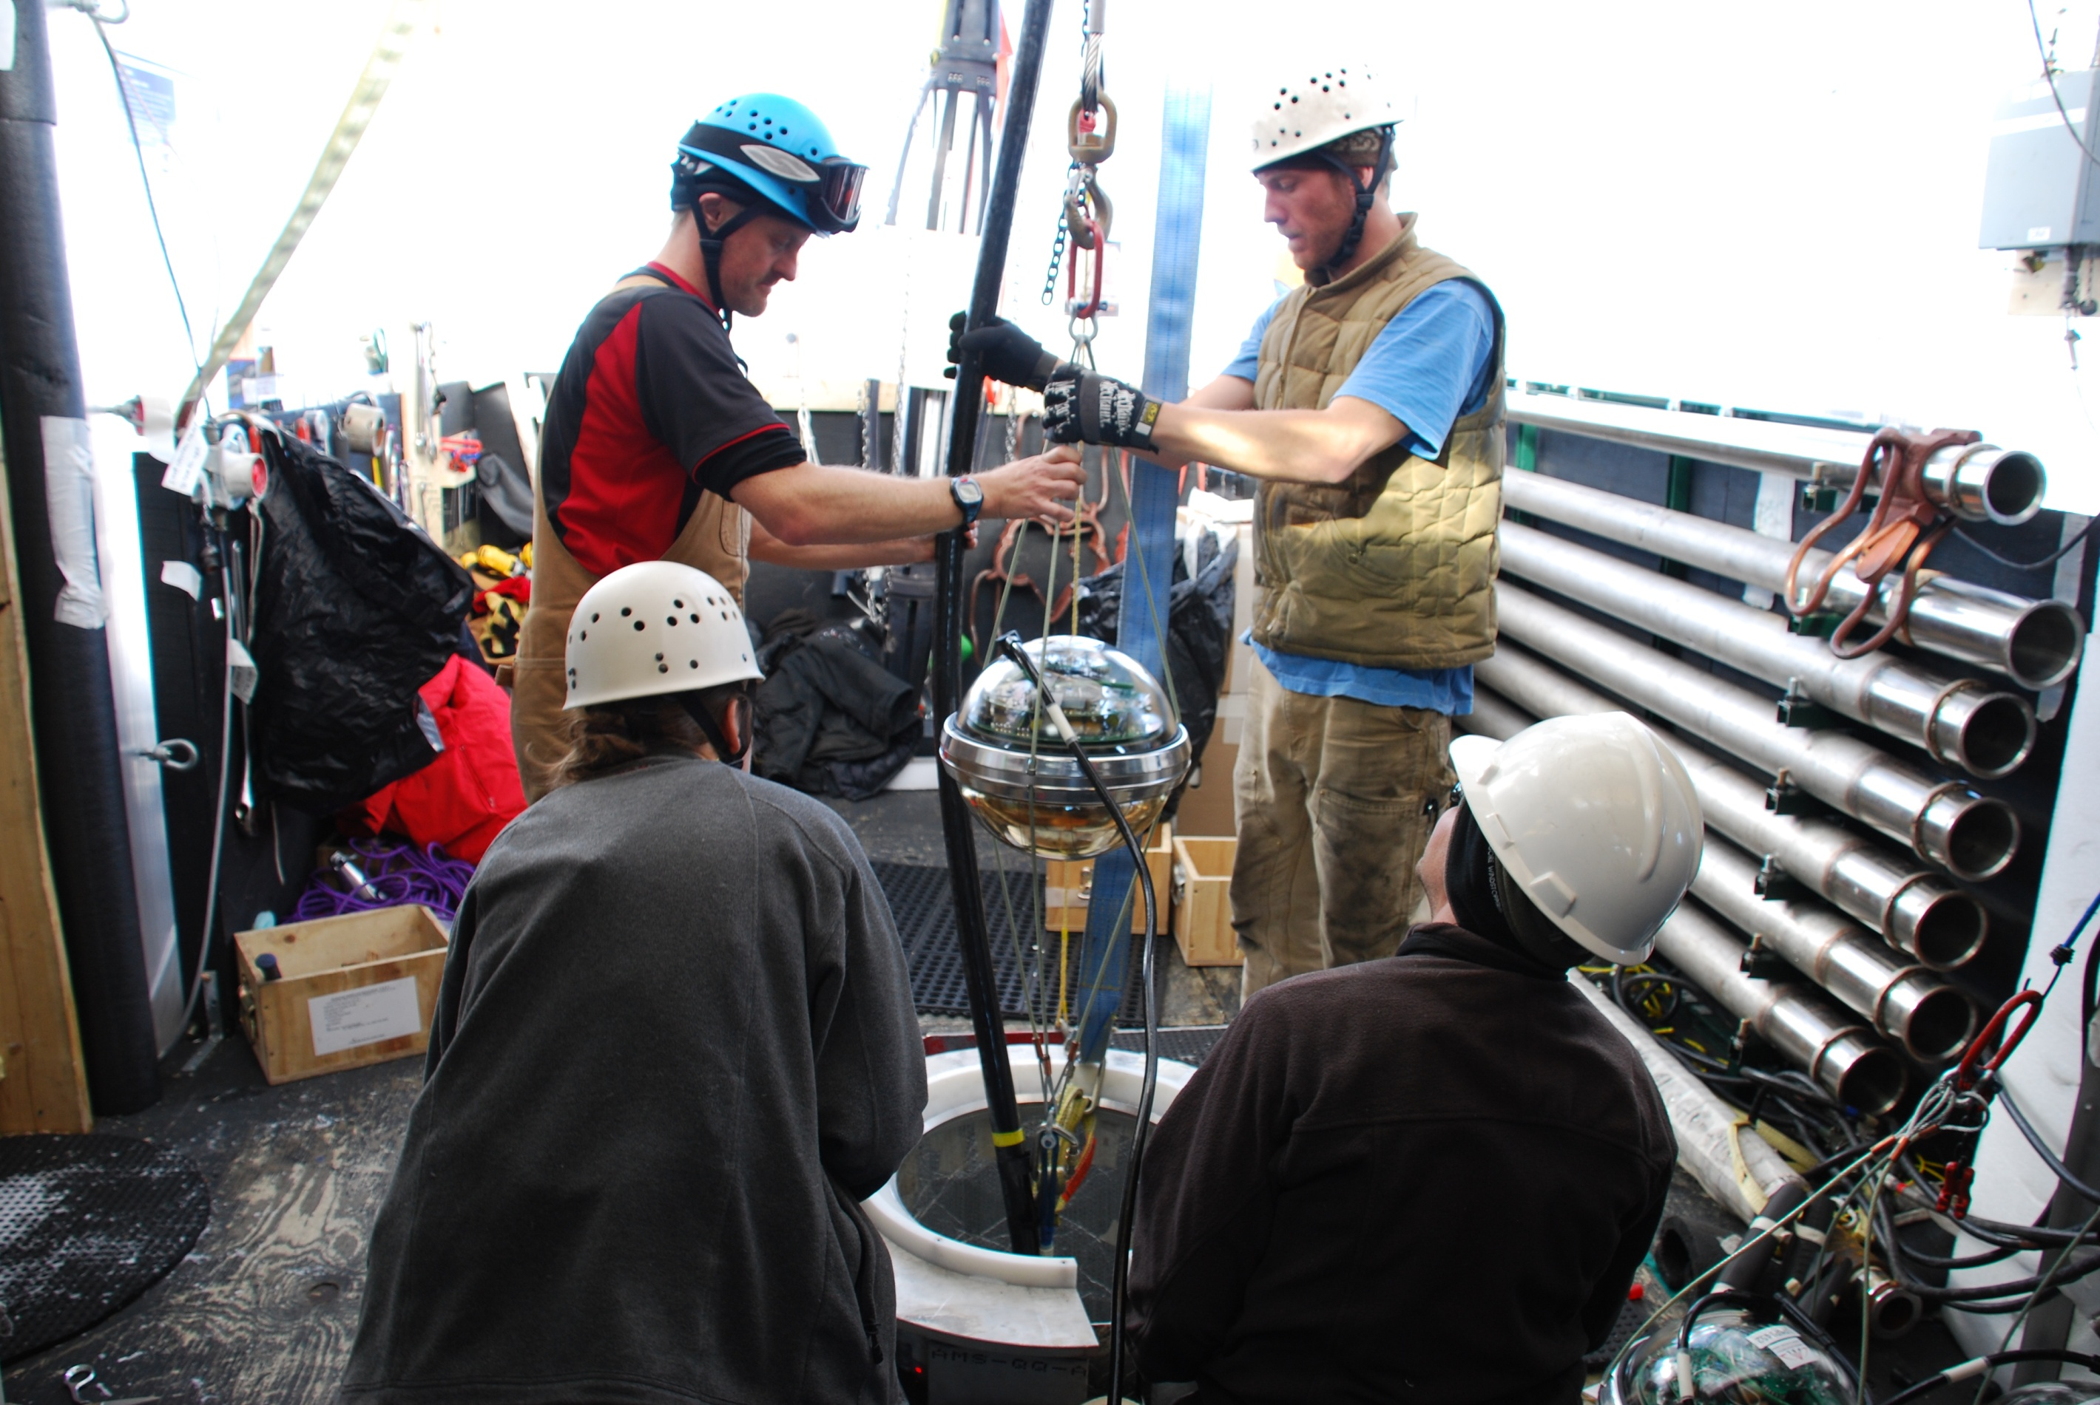

Slide 39
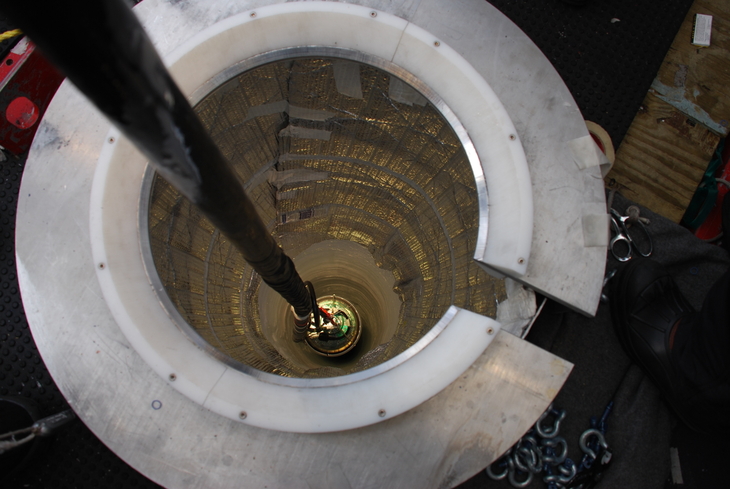

Slide 40

working at the south pole
Fun South Pole Facts
altitude: ~10,000 ft (9000 + thinner air)
mean temperature in Summer: -31F, -35C
mean temperature in Winter: -80F, -62C
precipitation: 2.5mm/yr (Portland: 922.02/yr)
summer population: 280
winter population: 45
water ration: 2 showers/week, 2 minutes each
sunrises or sunsets per year: 1
distance to McMurdo base: 840 miles / 1355 km
indigenous life: microbes
Antarctica has 90% of the earth’s fresh water locked up in its ice

Slide 41


Slide 42

~ 40 lbs

Slide 43


Slide 44

CHC to McM on a C17 out of McChord AFB

Slide 45

Inside C17

Slide 46


Slide 47


Slide 48

A not so pretty McMurdo Station

Slide 49


Slide 50

Finally to Pole…
LC-130 Herc from the 109th ANG wing from New York

Slide 51

Inside the Herc

Slide 52


Slide 53

9.5 million pounds of cargo (fuel and equipment) delivered to Pole in support of IceCube over last 8 seasons…lots of flights!
Herc landing at Pole

Slide 54

Arrival at Pole

Slide 55

Doesn’t fit anywhere else – cool airdrop pic at Pole

Slide 56

South Pole Station…nice digs

Slide 57


Slide 58

Home for 3 months

Slide 59


Slide 60

The Galley at Xmas

Slide 61

Xmas dinner

Slide 62

Santa arrives at SOUTH Pole for a change

Slide 63

Race Around the World (with dragon)

Slide 64

A first for the South Pole…history is made

Slide 65

Don’t forget the chariot

Slide 66

Safety first

Slide 67

New Year’s Eve

Slide 68


Slide 69


Thank You !
December 18, 2010 – Celebrating the completion of IceCube

